Slide 1

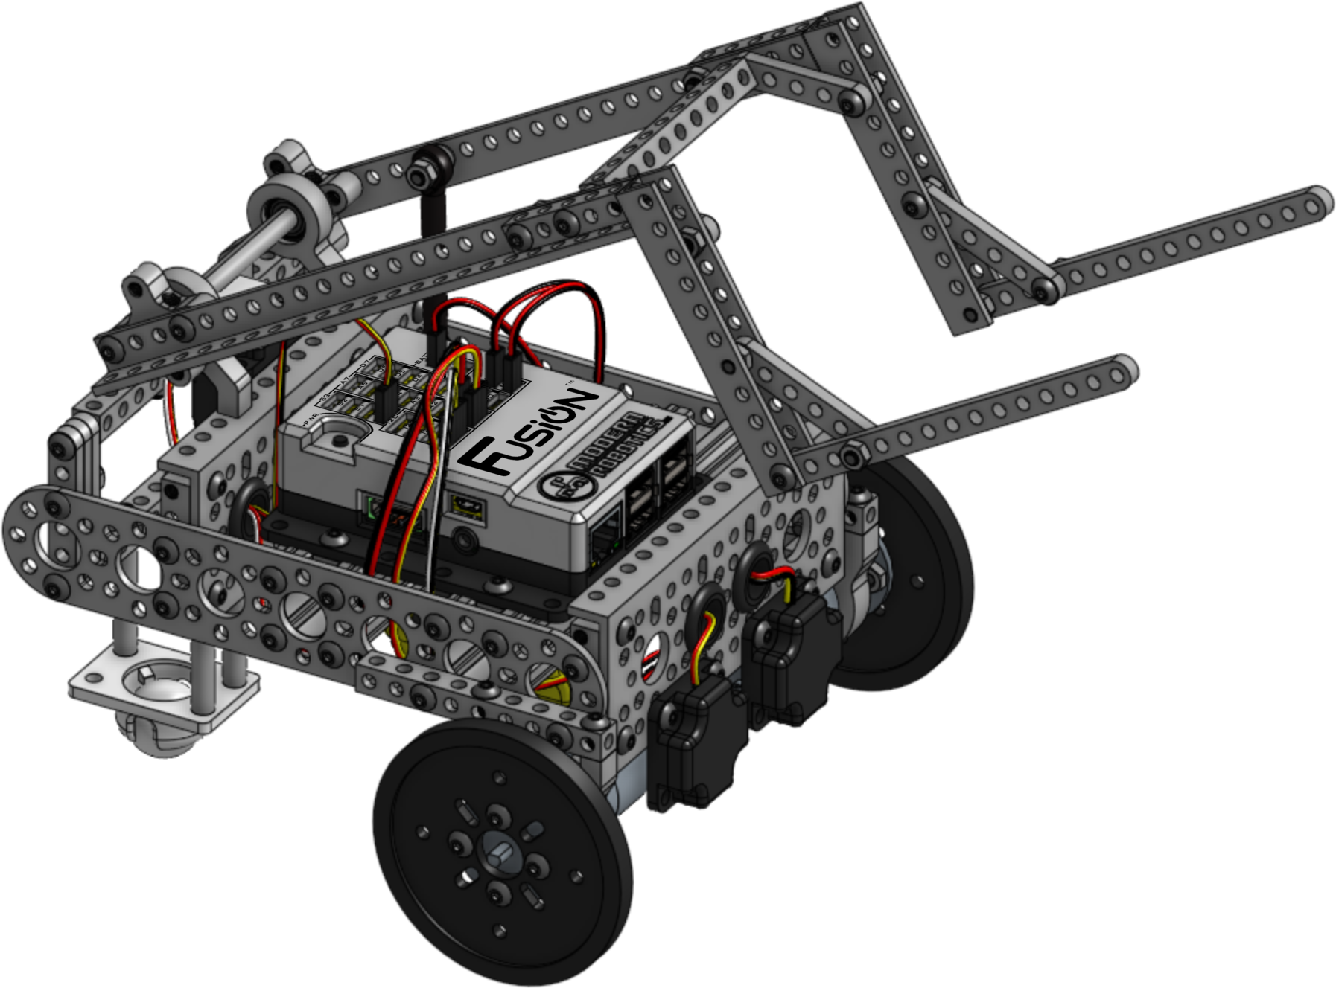

Forklift Bot
Building Instructions
Version 1.0.0
Modern Robotics, Inc.

Slide 2
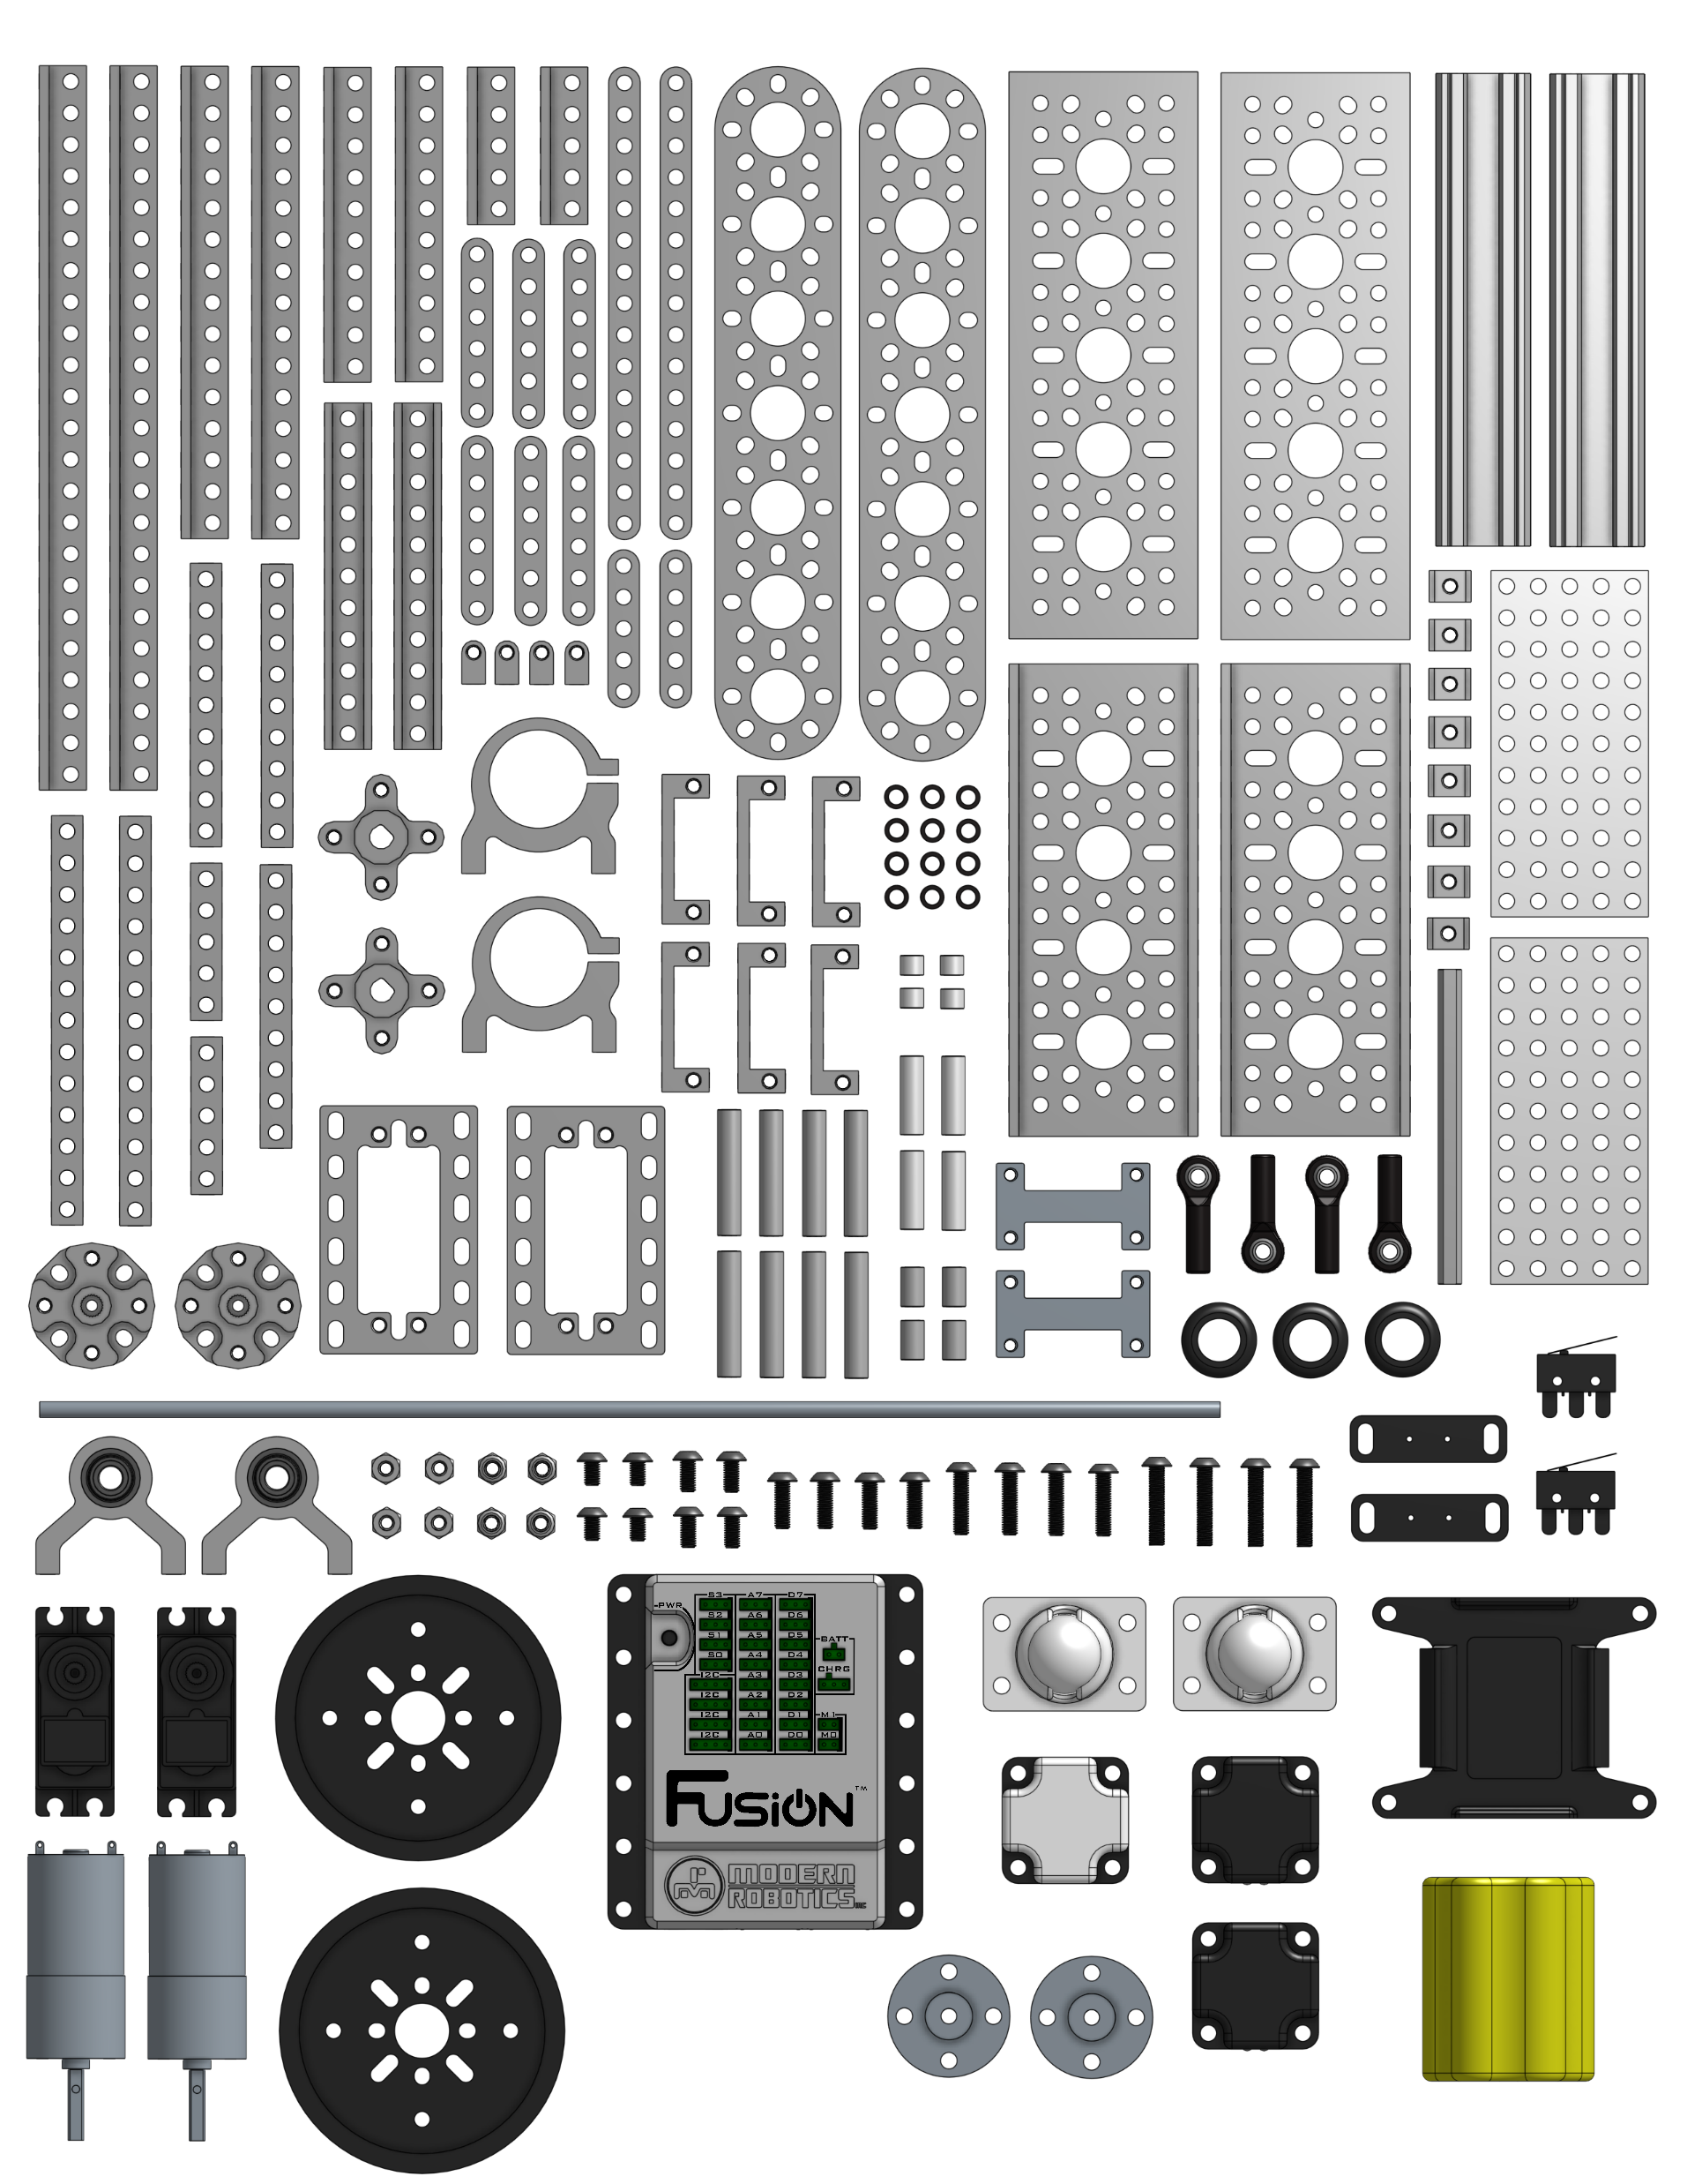
This document is published by Modern Robotics, Inc. No part of this document may be copied, published in print or shared online or otherwise publicly released without the express written consent of Modern Robotics, Inc.
Specifications subject to change without notice.

Slide 3
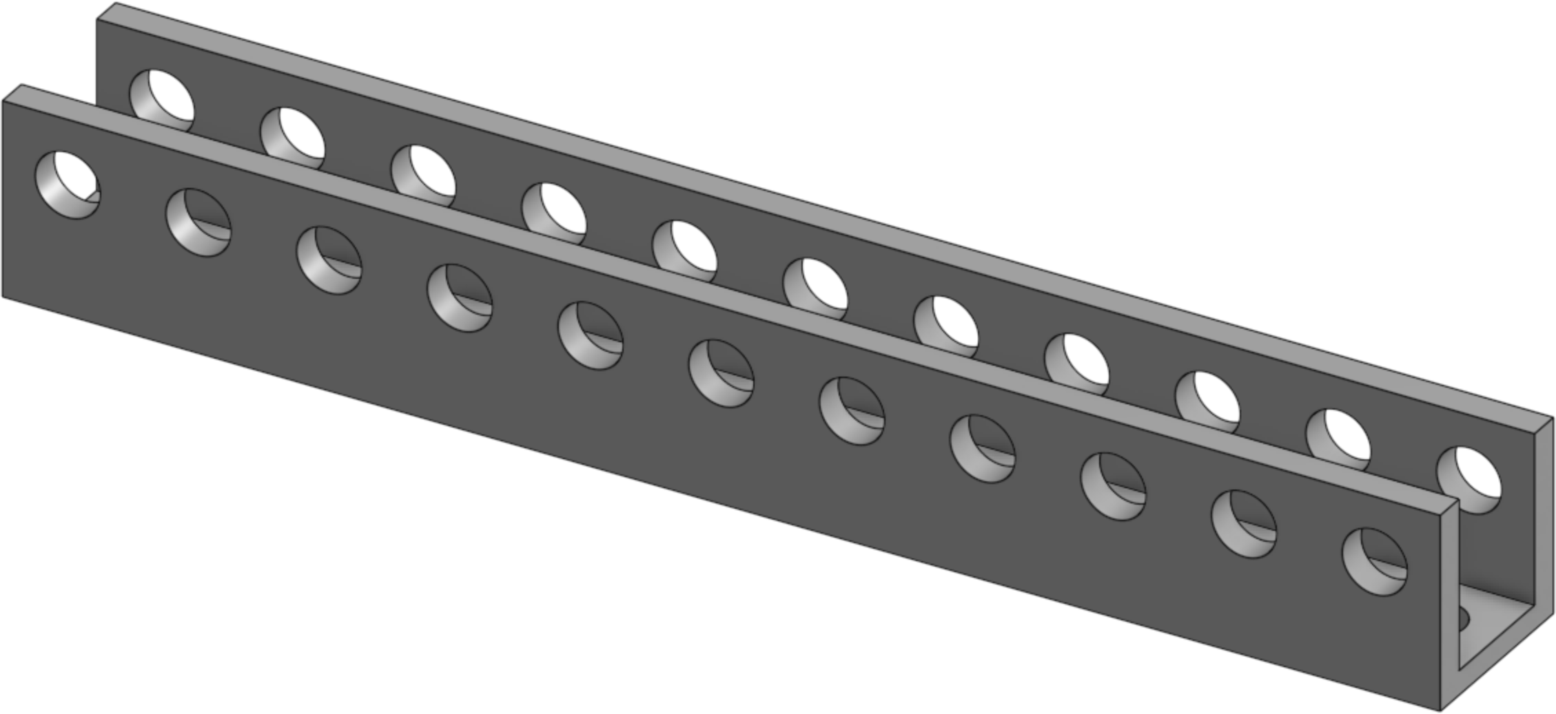
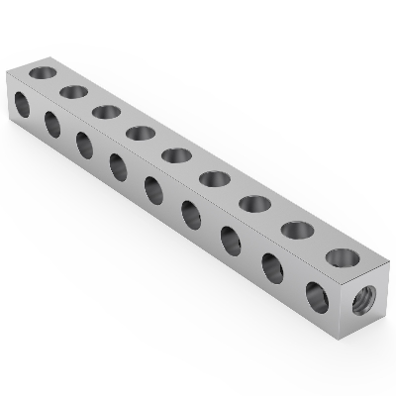
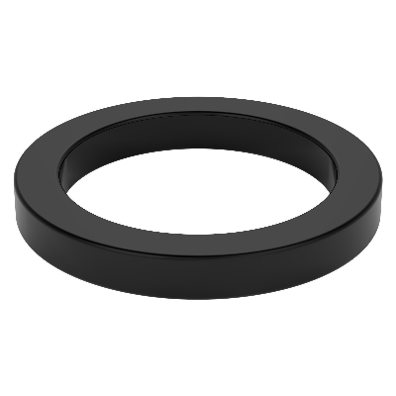
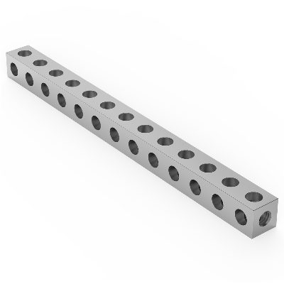
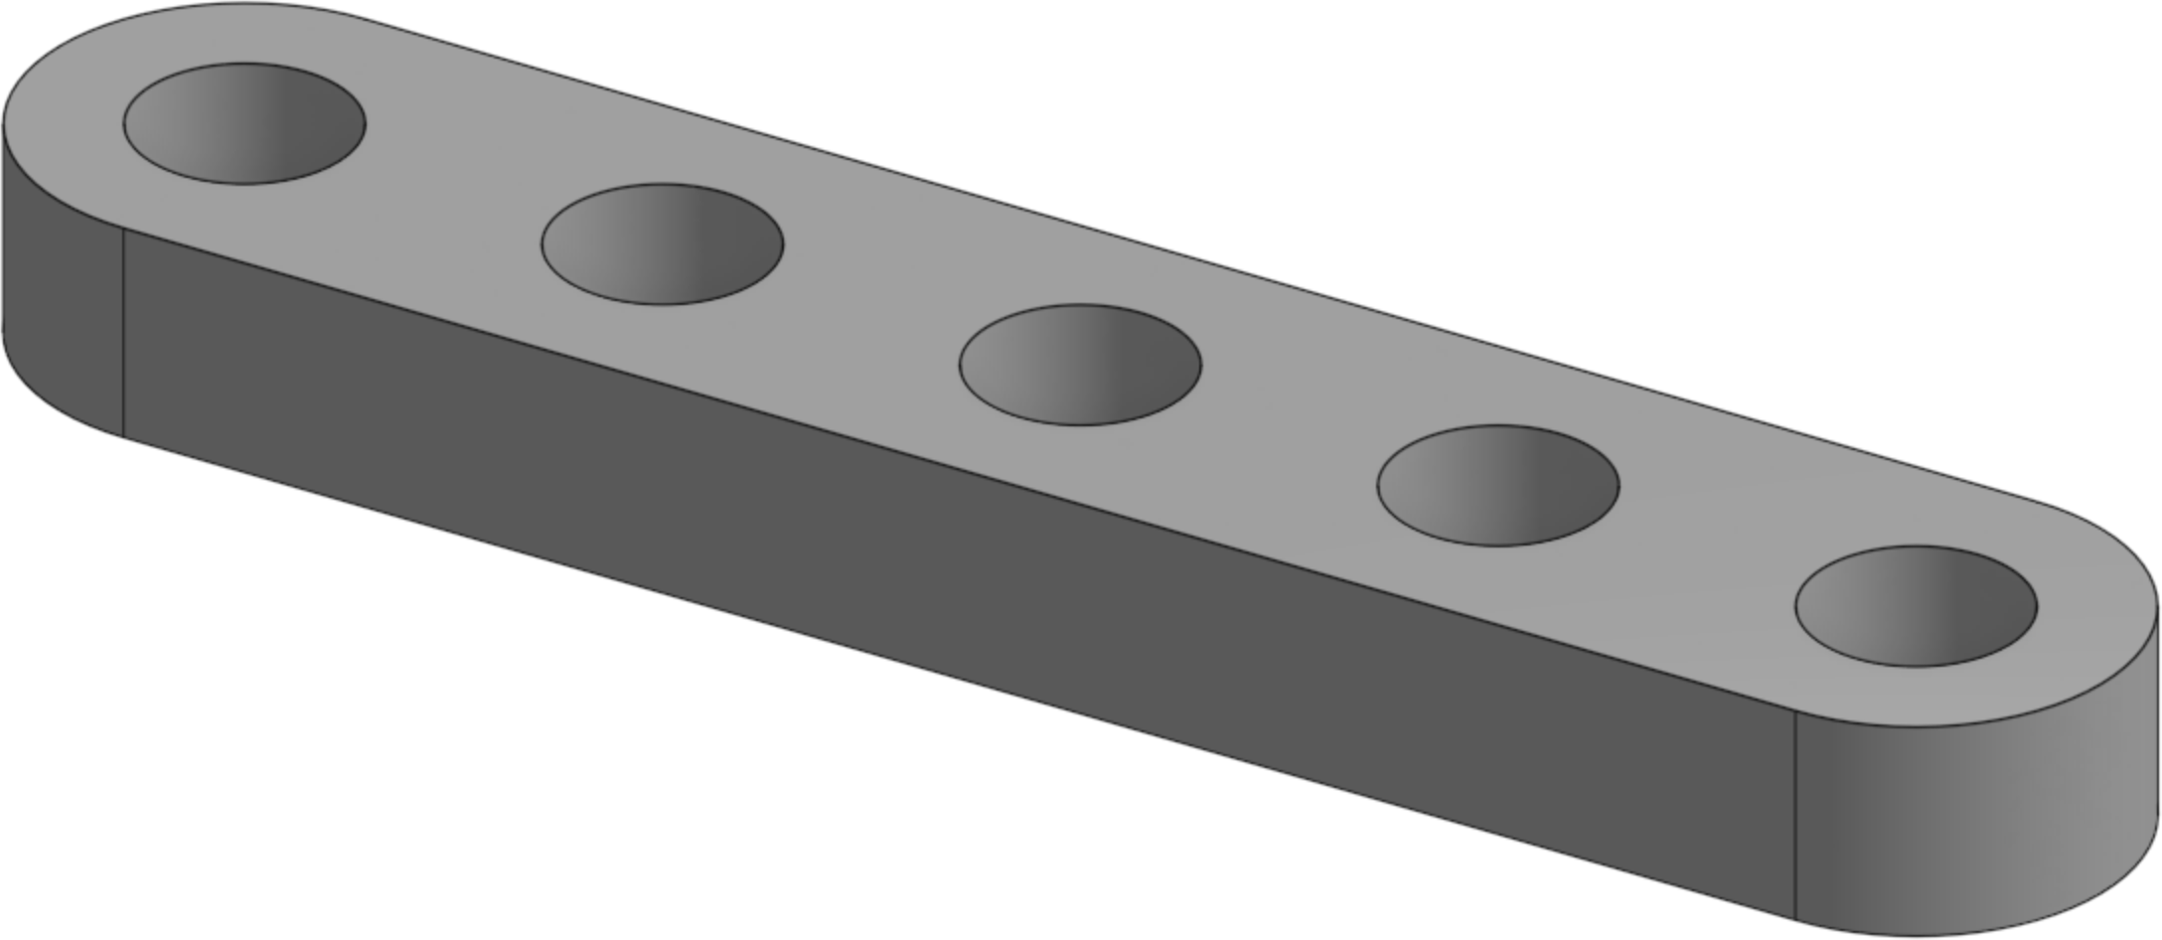
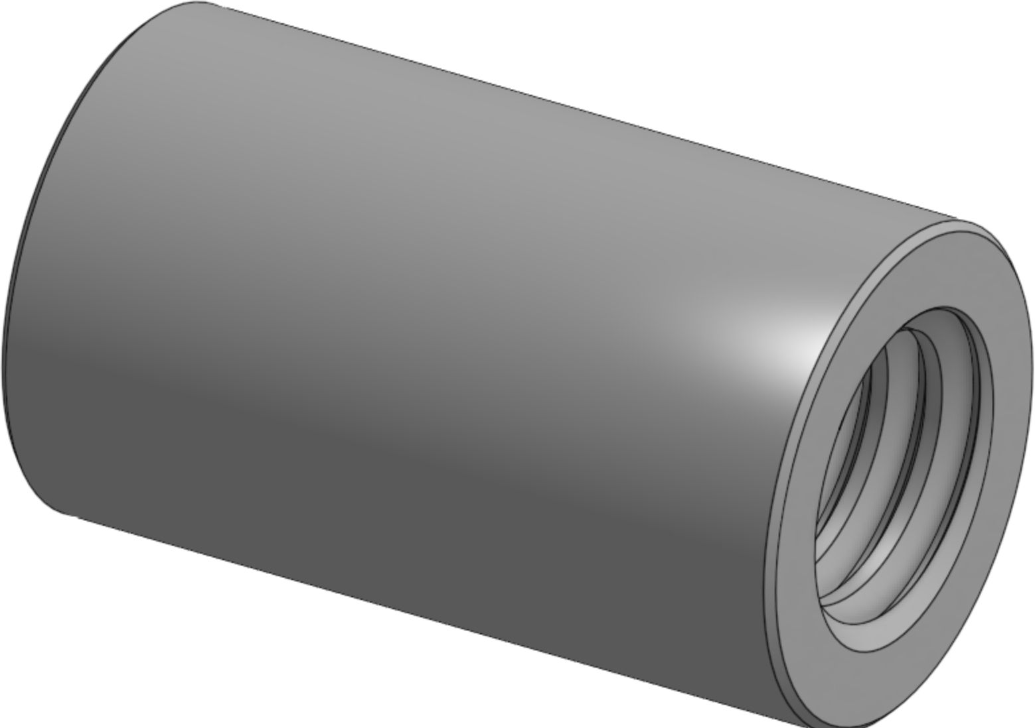
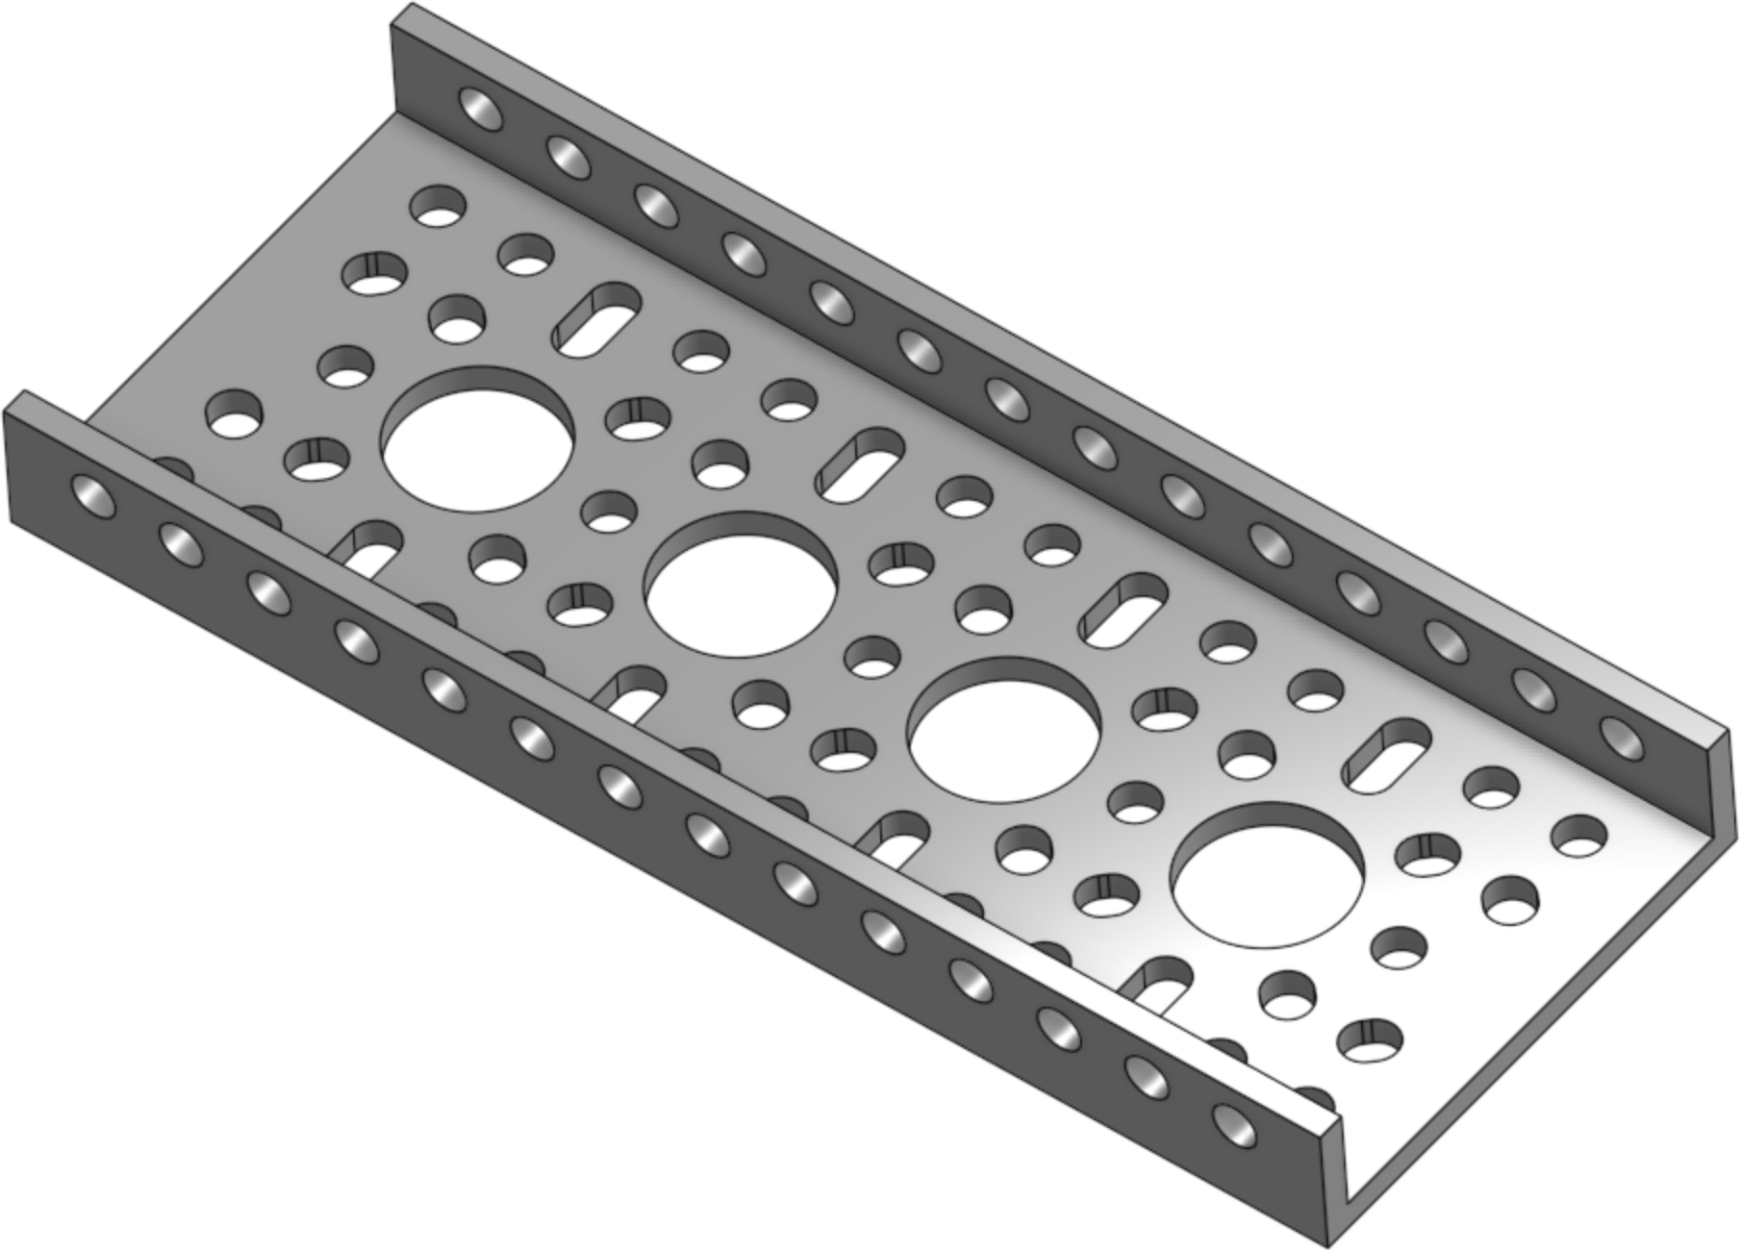
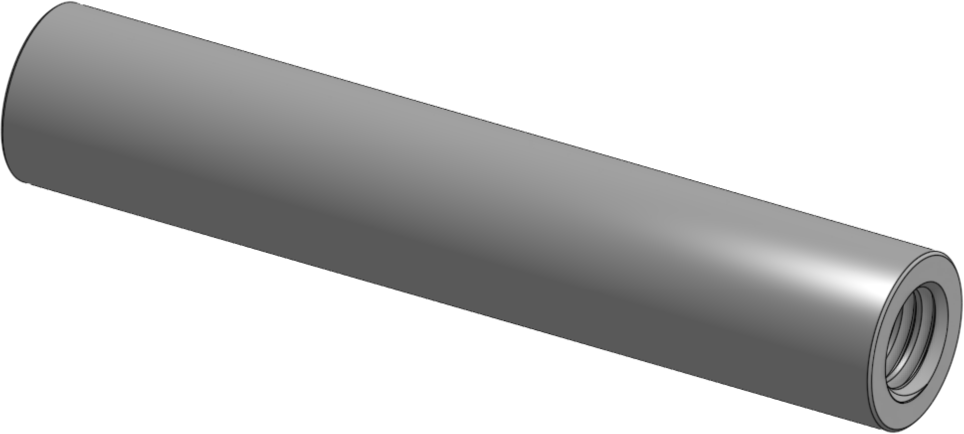
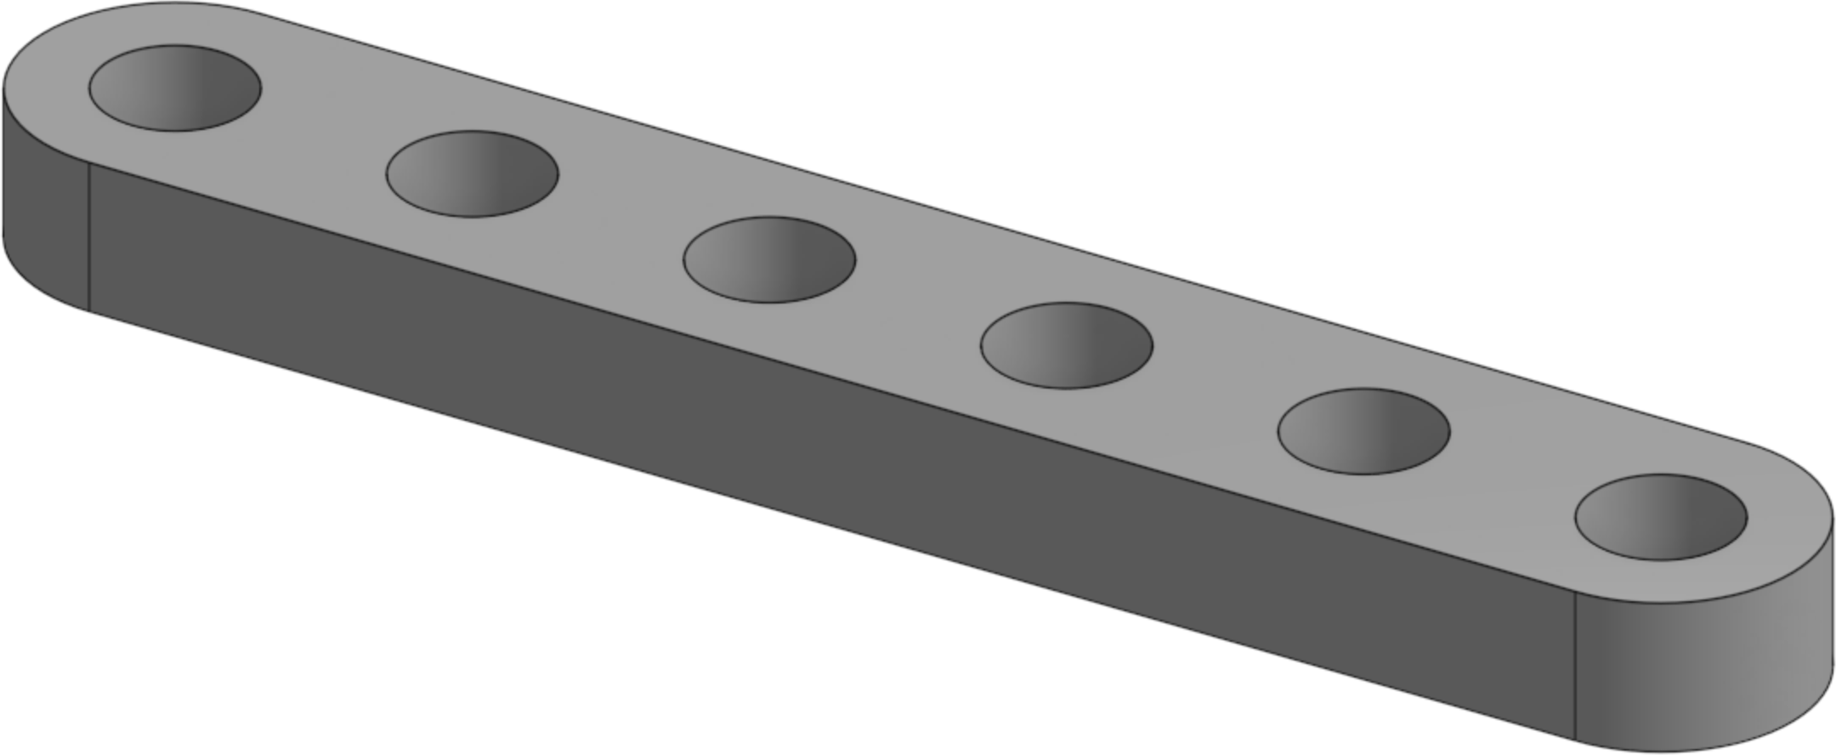
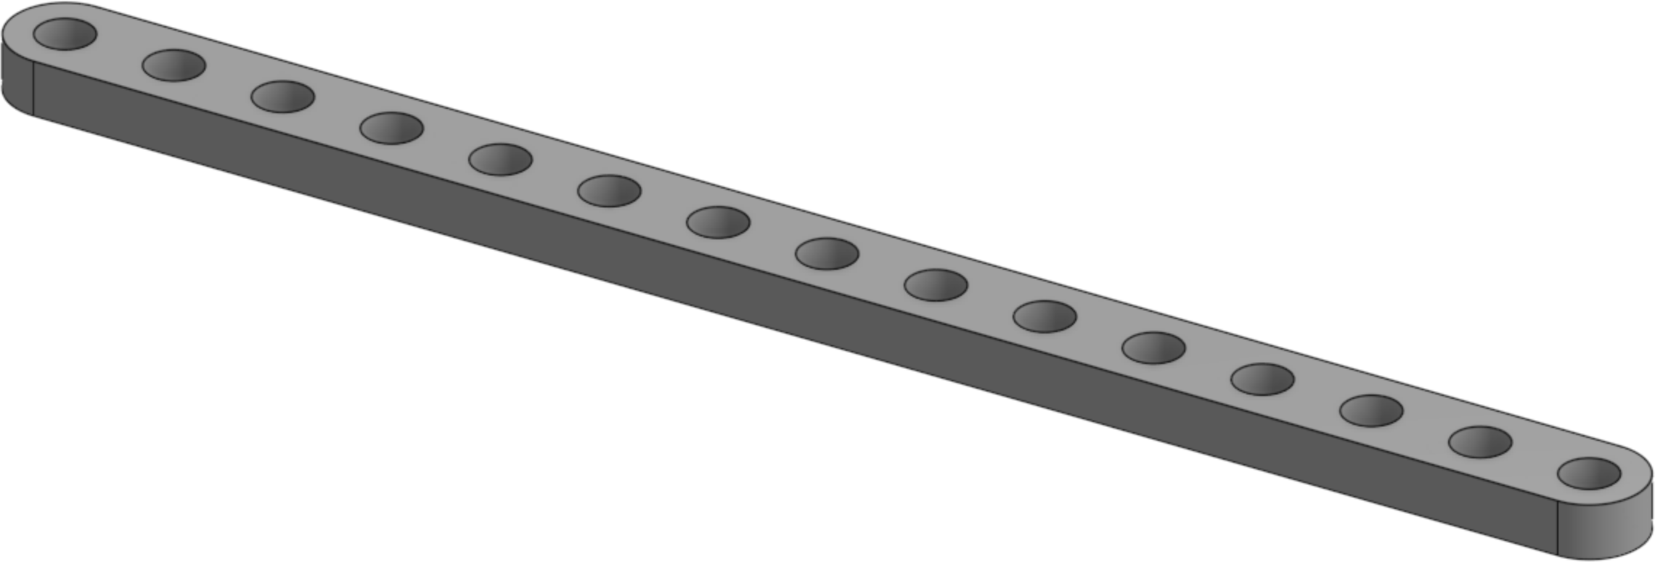
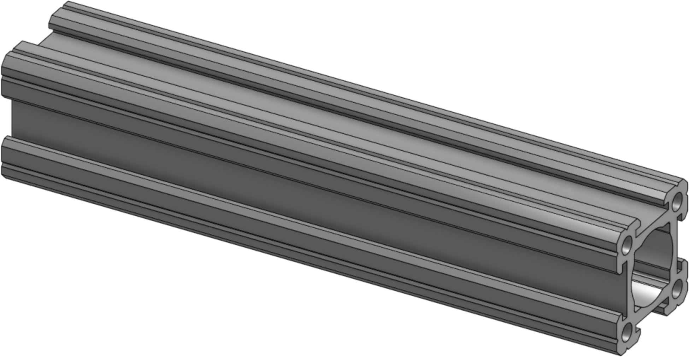
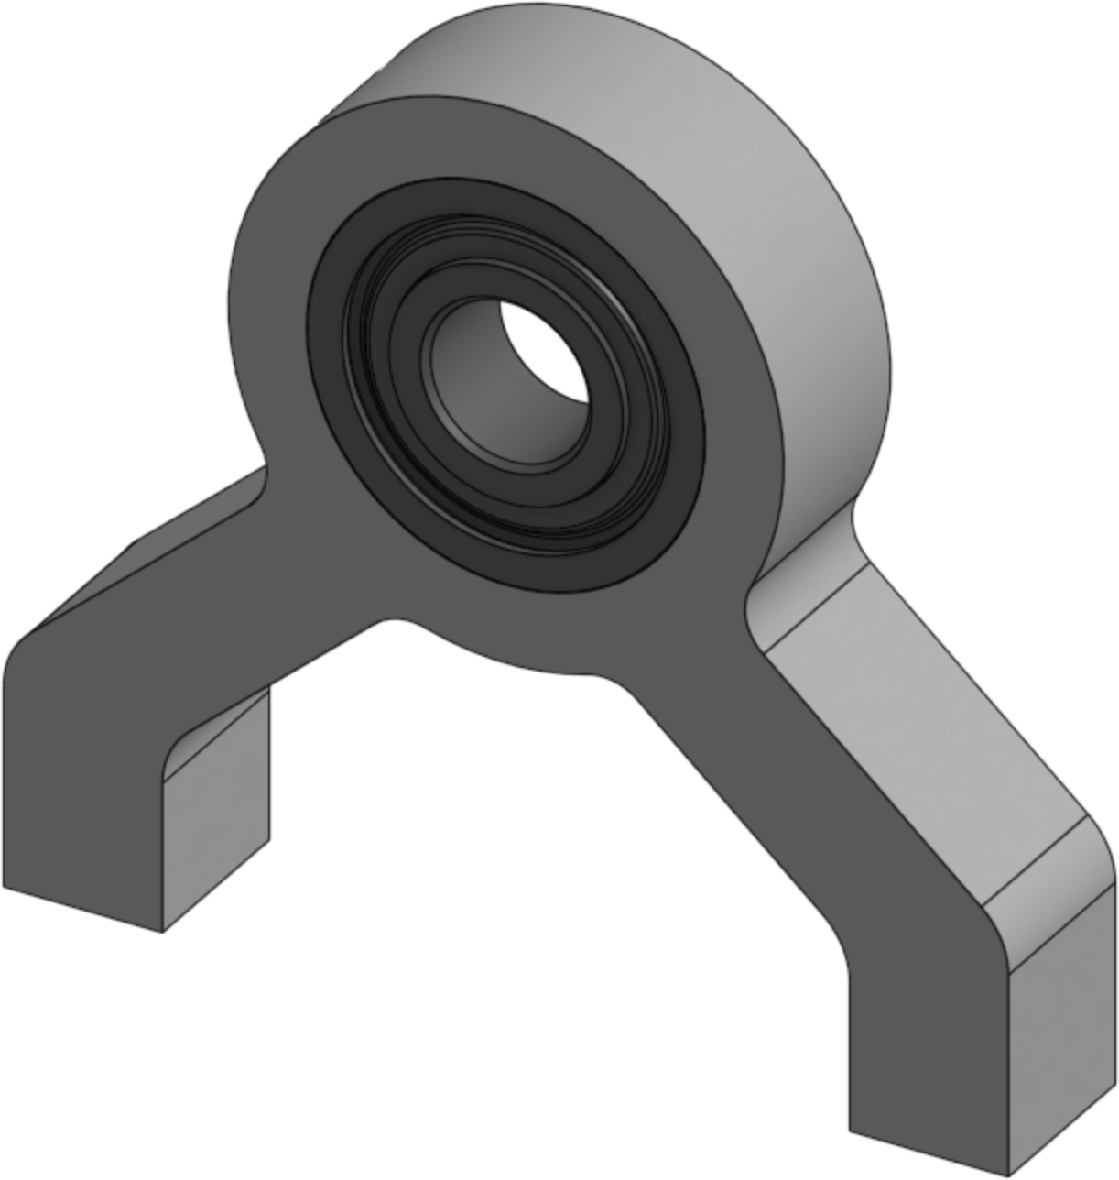
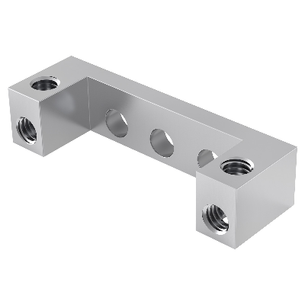
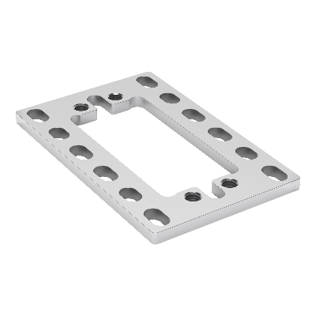
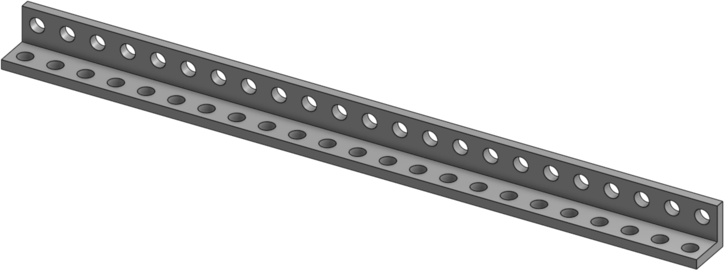
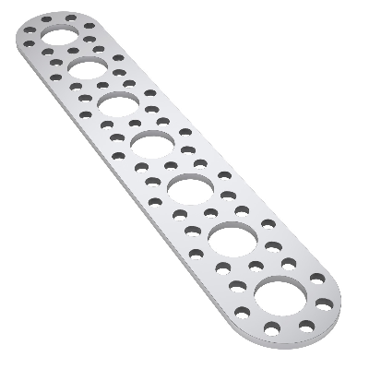
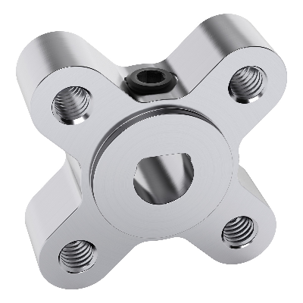
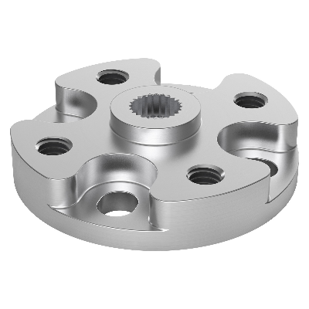
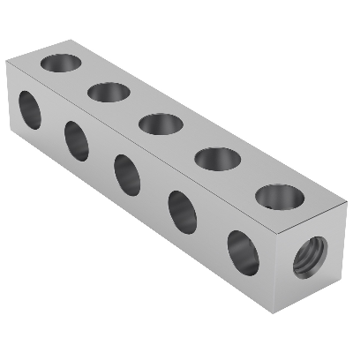
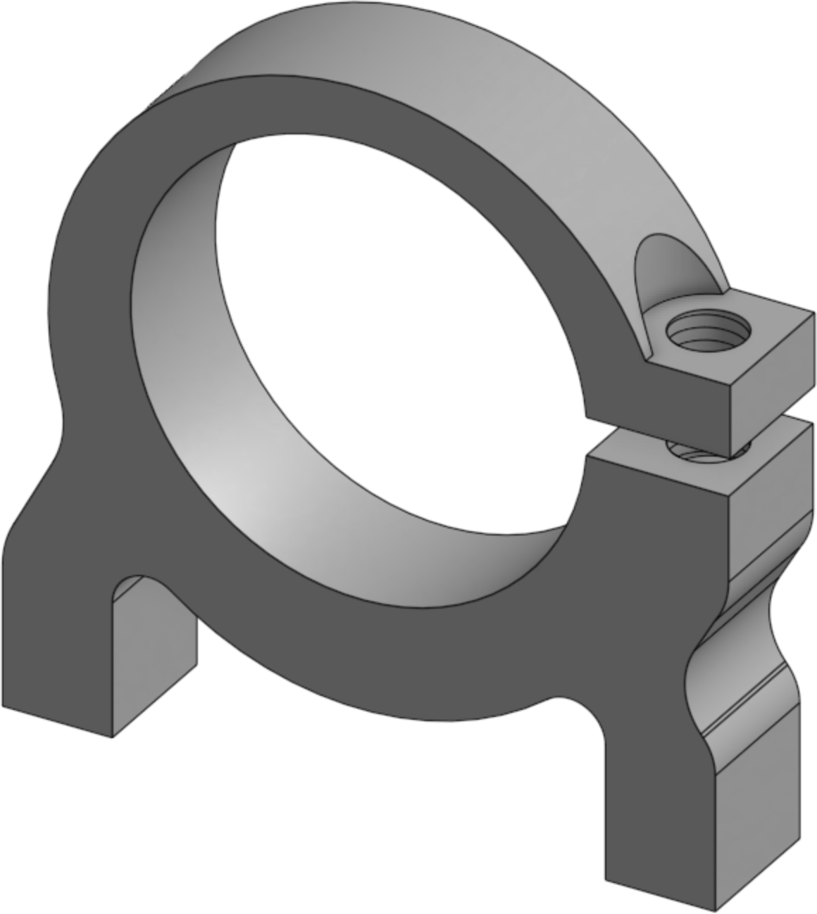
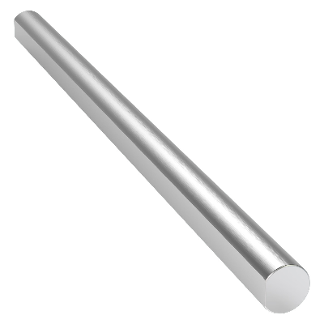
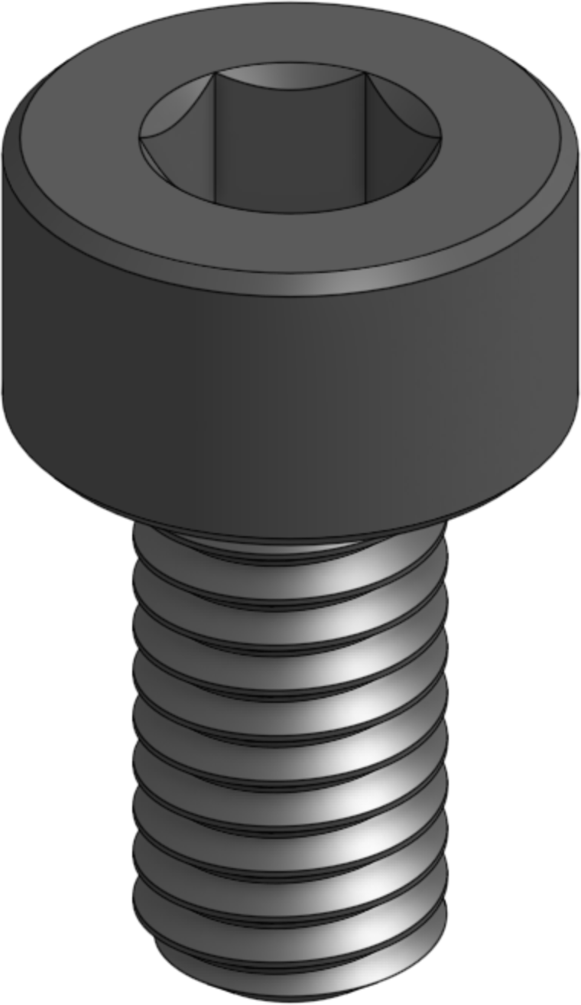
Bill of Materials
x2 1101-0011-0088 11 Hole, 88mm U-Beam | x3 1106-0009-0072 9 Hole, 72mm Square Beam | x2 1500-0001-0004 4mm ID x 6mm OD x 1mm Thick Wall Plastic Spacer
x2 1102-0005-0040 5 Hole, 40mm Flat Beam | x2 1106-0013-0104 13 Hole, 104mm Square Beam | x2 1501-0006-0010 10mm L x 6mm D 4mm Tapped Aluminum Standoff
x6 1102-0006-0048 6 Hole, 48mm Flat Beam | x2 1107-0004-0120 4 Hole, 120mm Low U-Channel | x6 1501-0006-0032 32mm L x 6mm D 4mm Tapped Aluminum Standoff
x2 1102-0015-0120 15 Hole, 120mm Flat Beam | x2 1109-0024-0120 120mm Standard Go-Rail | x2 1602-0032-0006 6mm Bore Bottom Tapped Pillow Block
x2 1103-0023-0184 23 Hole, 184mm L-Beam | x4 1205-0032-0002 Bridged Attachment Block | x1 1801-0040-0001 Servo Plate (Standard Servo)
x2 1105-0007-0176 7 Hole, 176mm Pattern Plate | x2 1303-0024-0006 6mm D-Bore Face Mount Set Screw | x1 1908-0024-0032 Standard Round Servo Horn (24T)
x2 1106-0005-0040 5 Hole, 40mm Square Beam | x2 1400-0032-0025 25mm Bore Clamp Mount | x1 2101-0006-0080 6mm x 80mm D-Shaft

Slide 4
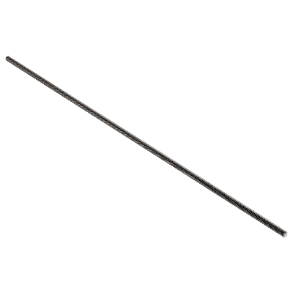
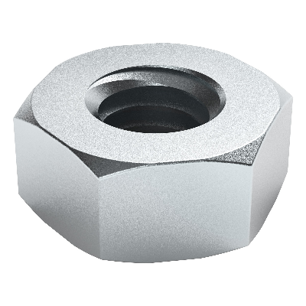
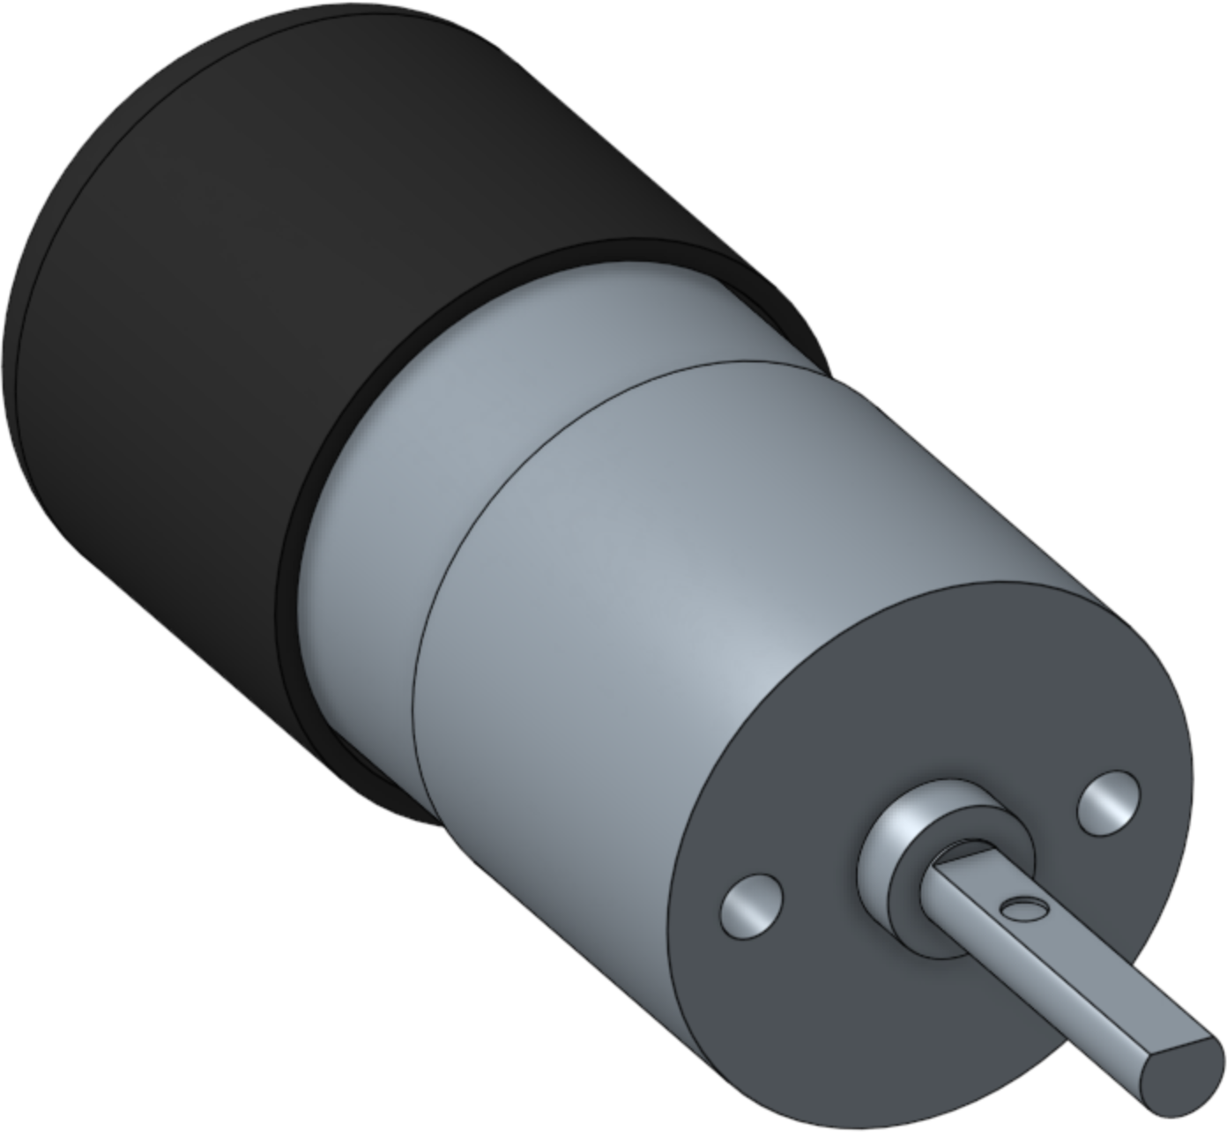
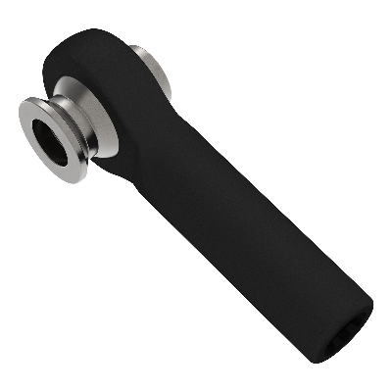
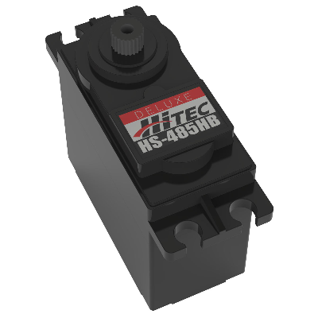
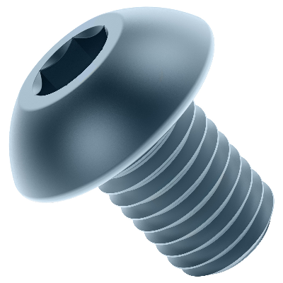
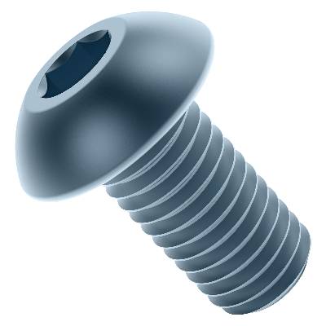
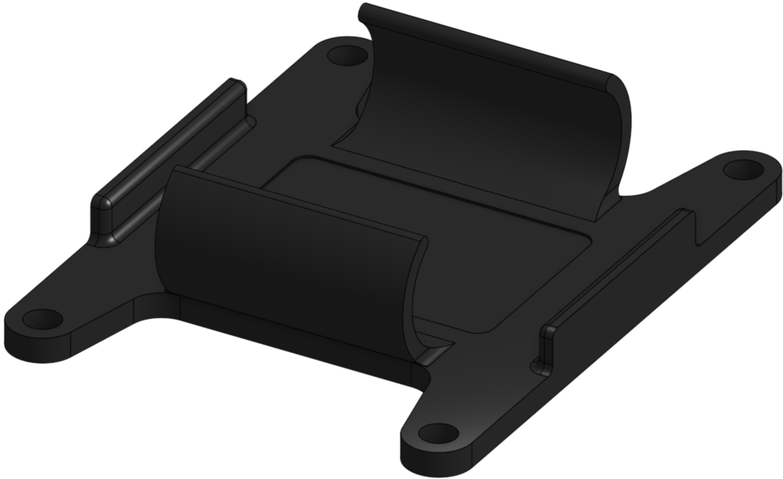
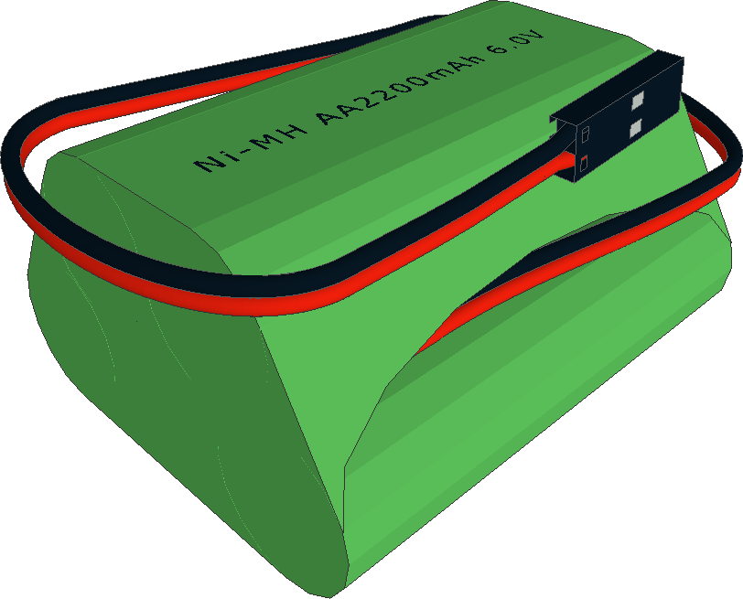
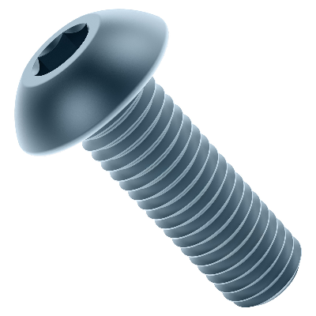
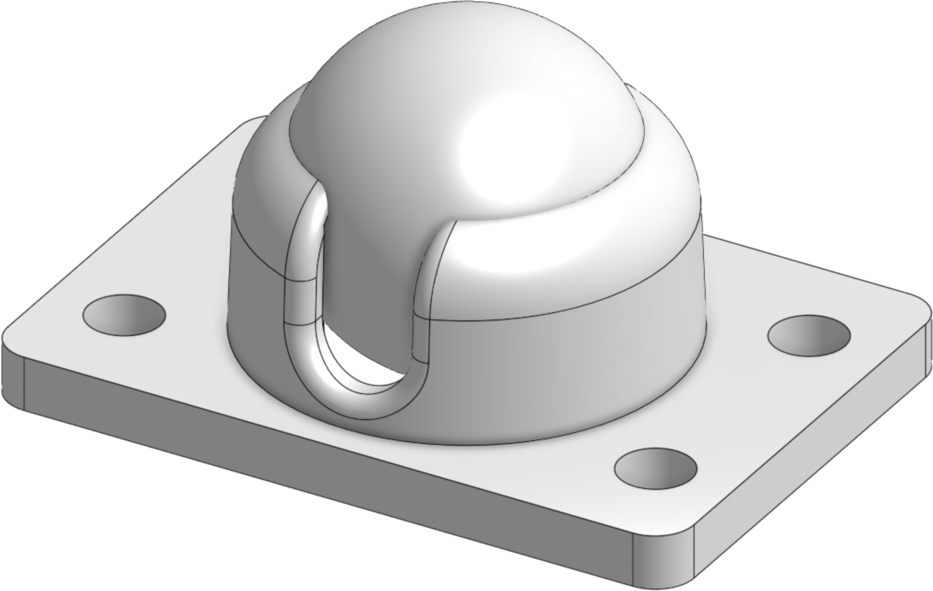
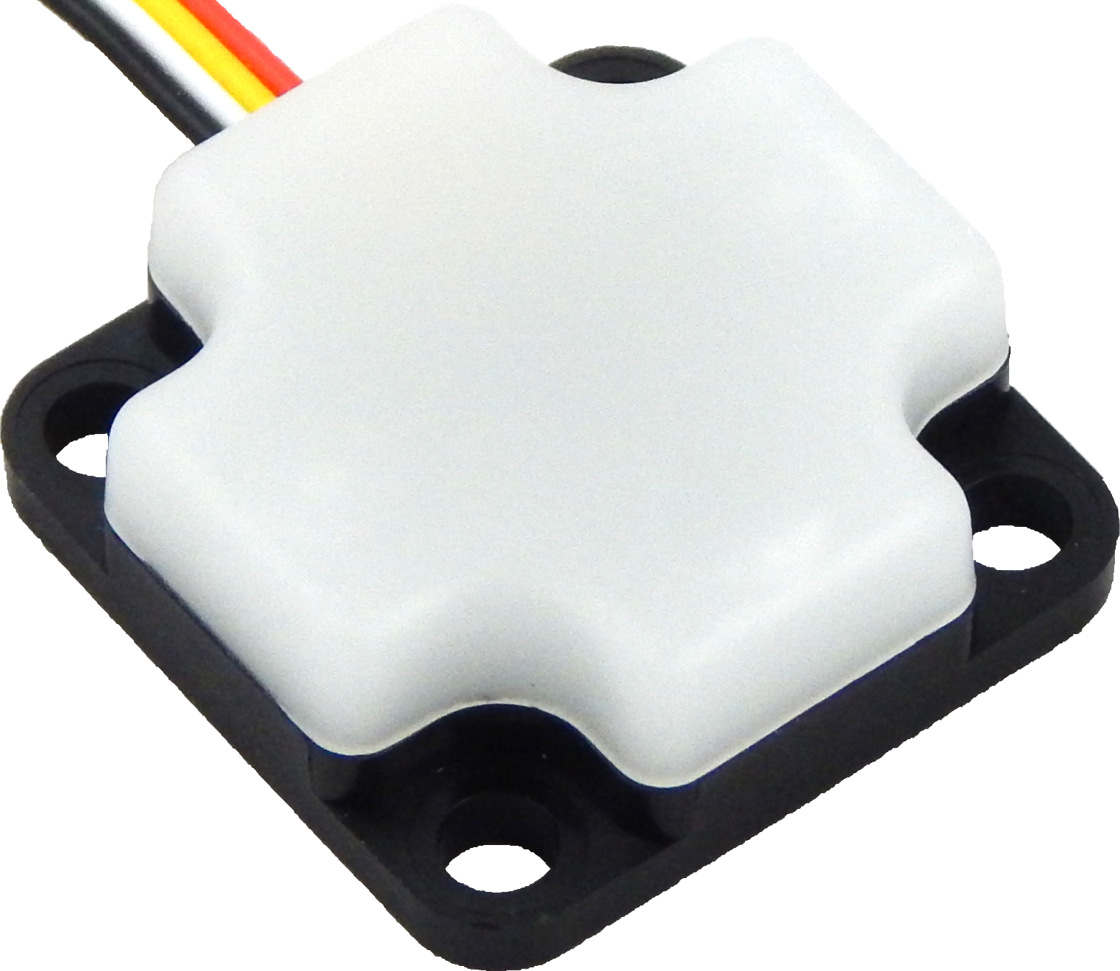
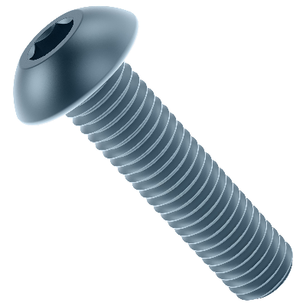
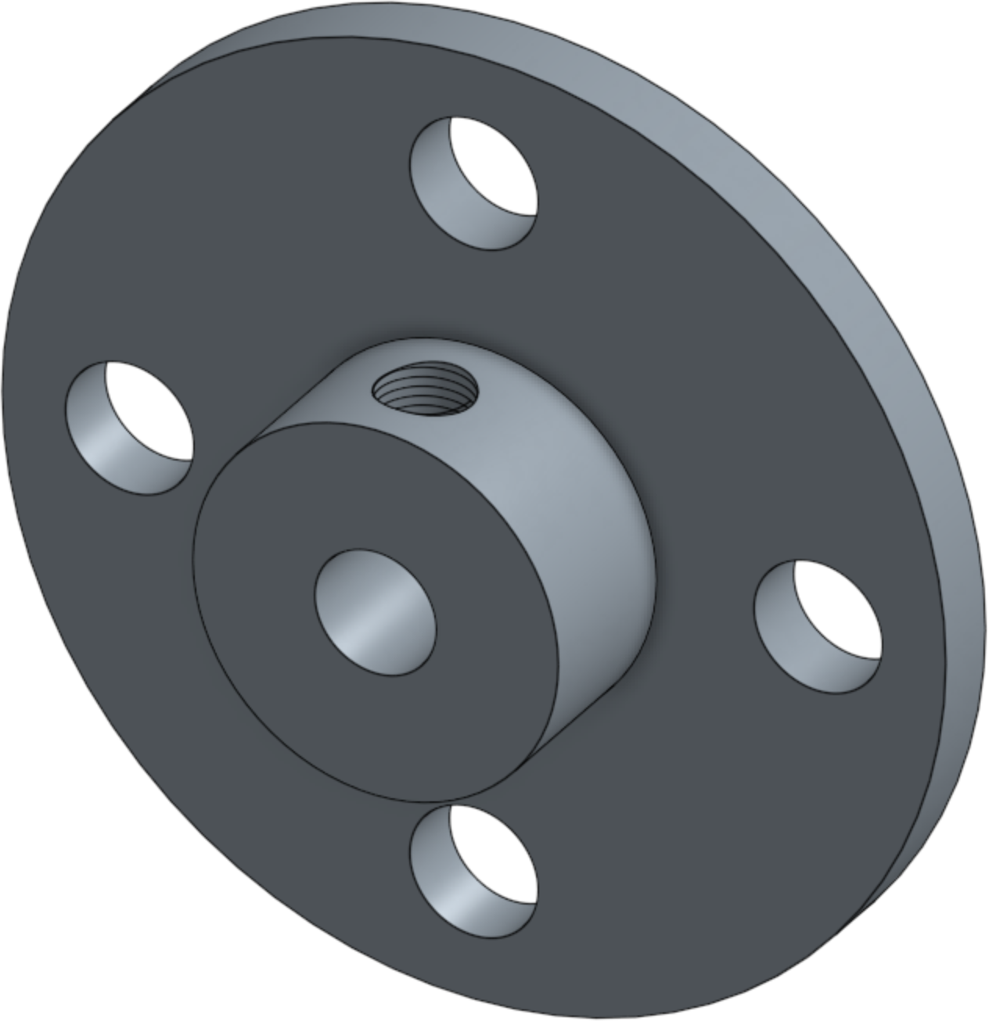
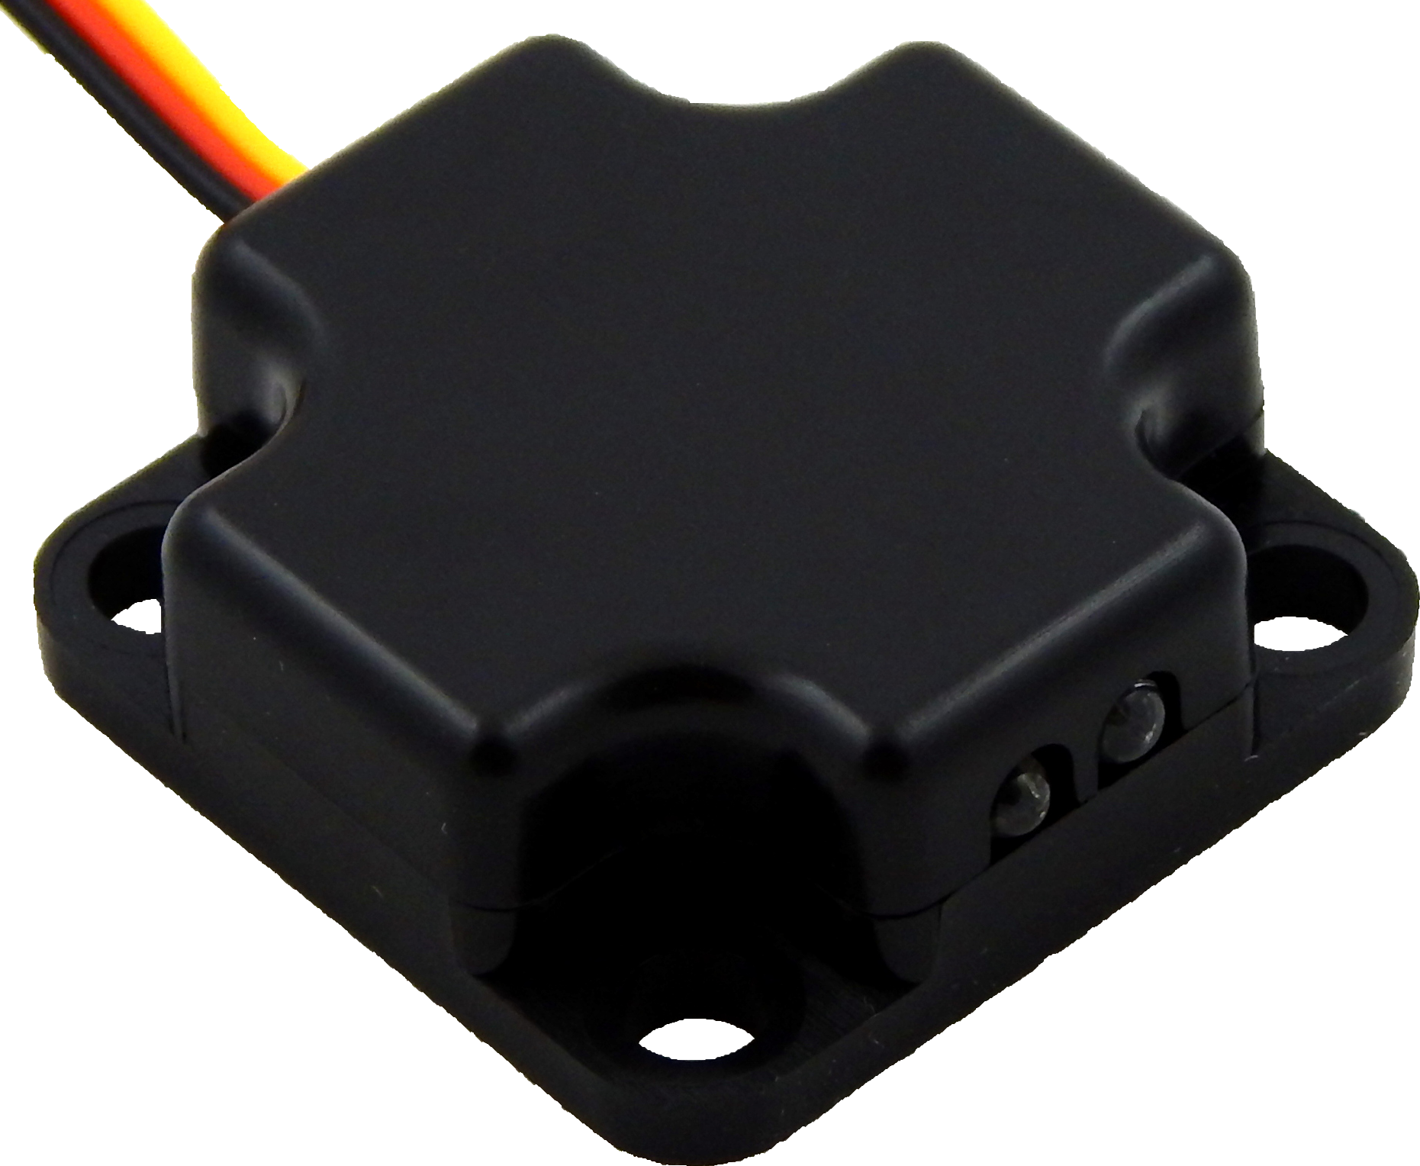
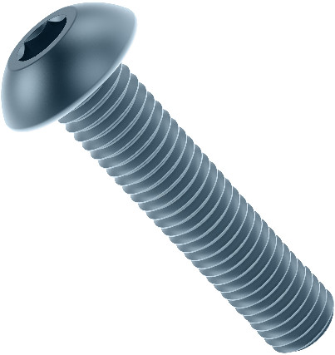

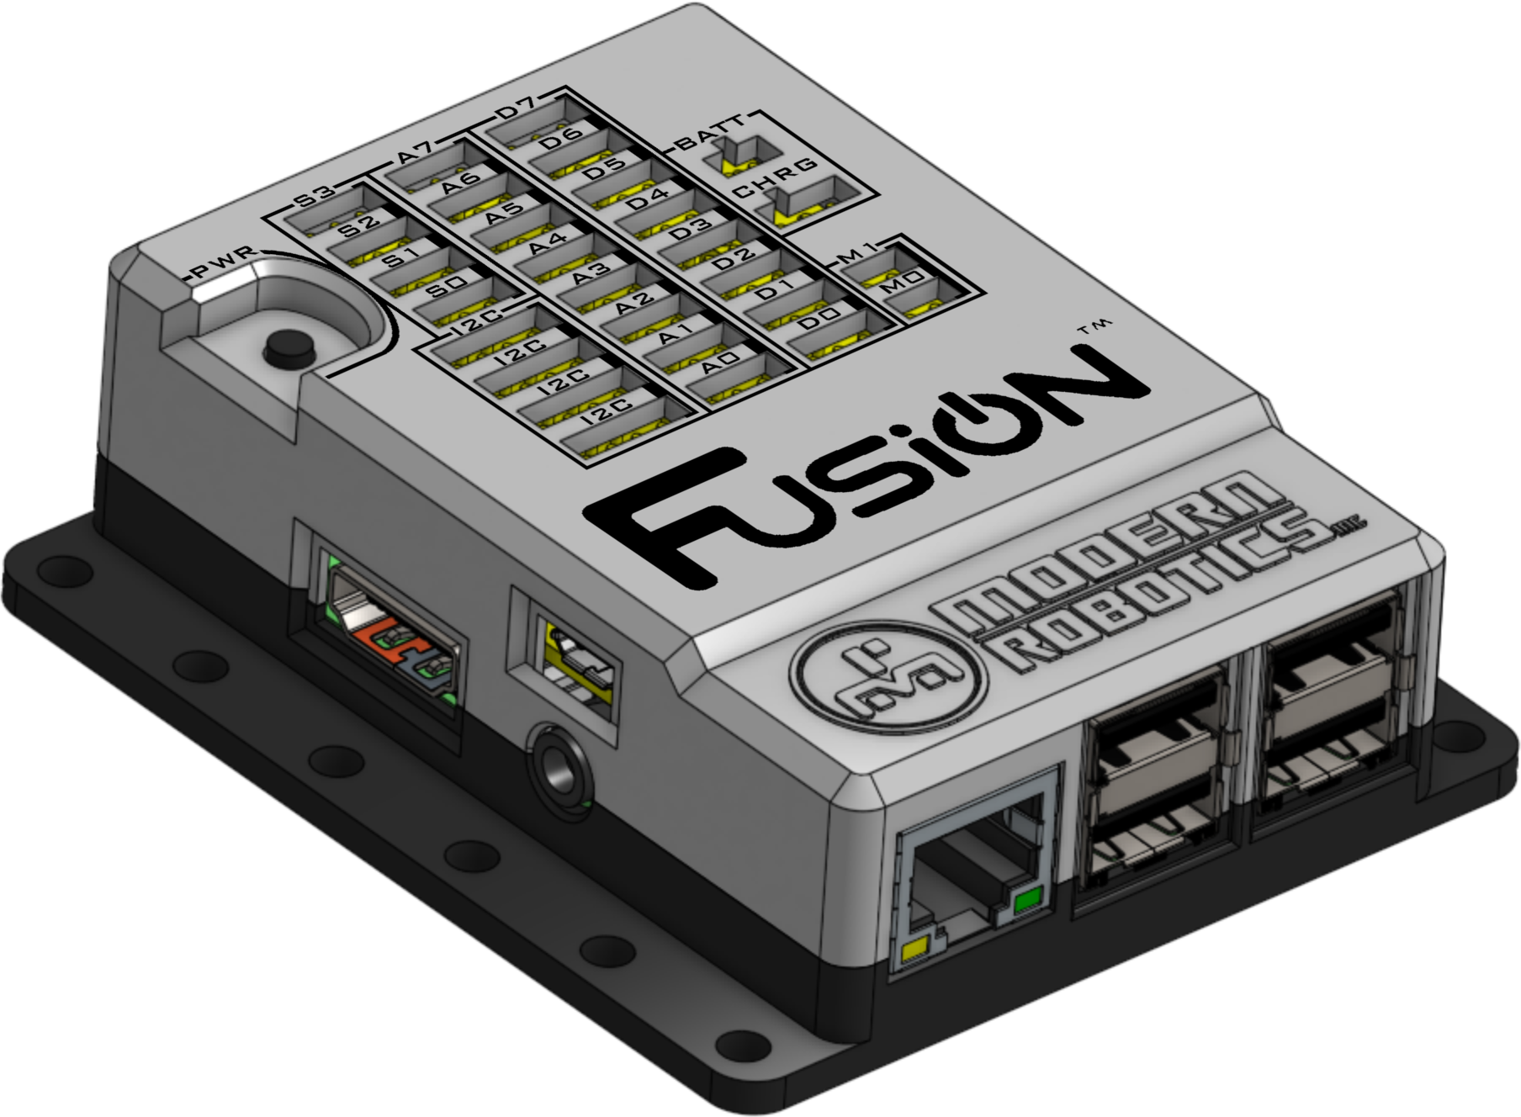
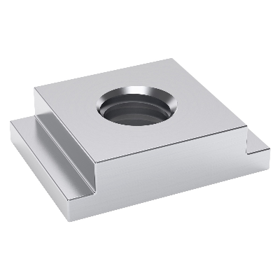
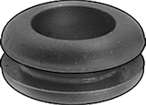
Bill of Materials
x31 2801-0004-0008 M4 x 0.7 Hex Nut | x1 2808-0004-0300 300mm M4 Threaded Rod | x2 14-0134 6V DC Motor
x22 2802-0004-0006 M4 x 6mm Screws | x2 2903-0004-0245 M4 Ball Linkages | x1 Hitec HS-485HB Servo
x34 2802-0004-0008 M4 x 8mm Screws | x1 45-0300 Battery Pack Mount | x1 45-1300 6V Battery Pack
x21 2802-0004-0012 M4 x 12mm Screws | x2 45-2100 19mm Ball Caster | x1 45-2005 Integrating Gyro
x22 2802-0004-0016 M4 x 16mm Screws | x2 60-0026 4-Hole Wheel Hub | x2 45-2006 Optical Distance Sensor
x7 2802-0004-0020 M4x 20mm Screws | x2 3607-0014-0072 72mm Economy Wheels | x1 52-2022 Fusion Controller
x8 2805-0004-0008 M4, 1 Hole Slide Nut | x3 45-1005 Push-In Grommet

Slide 5
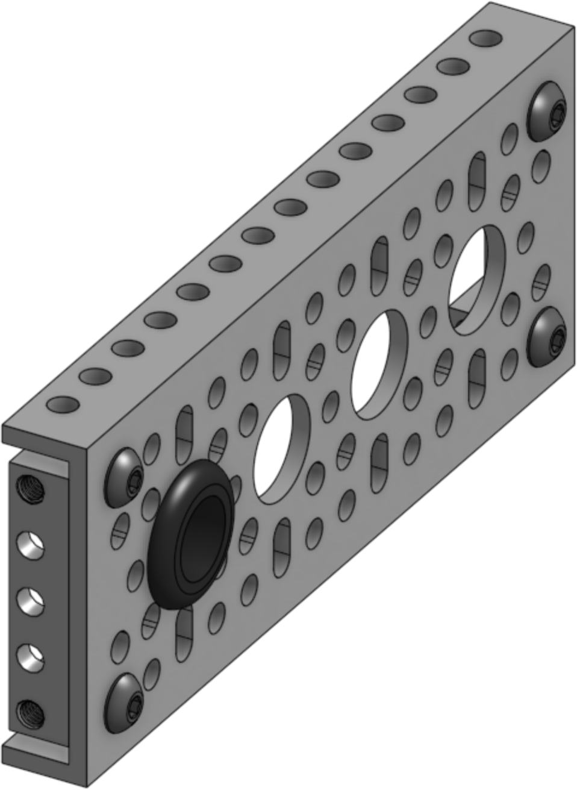
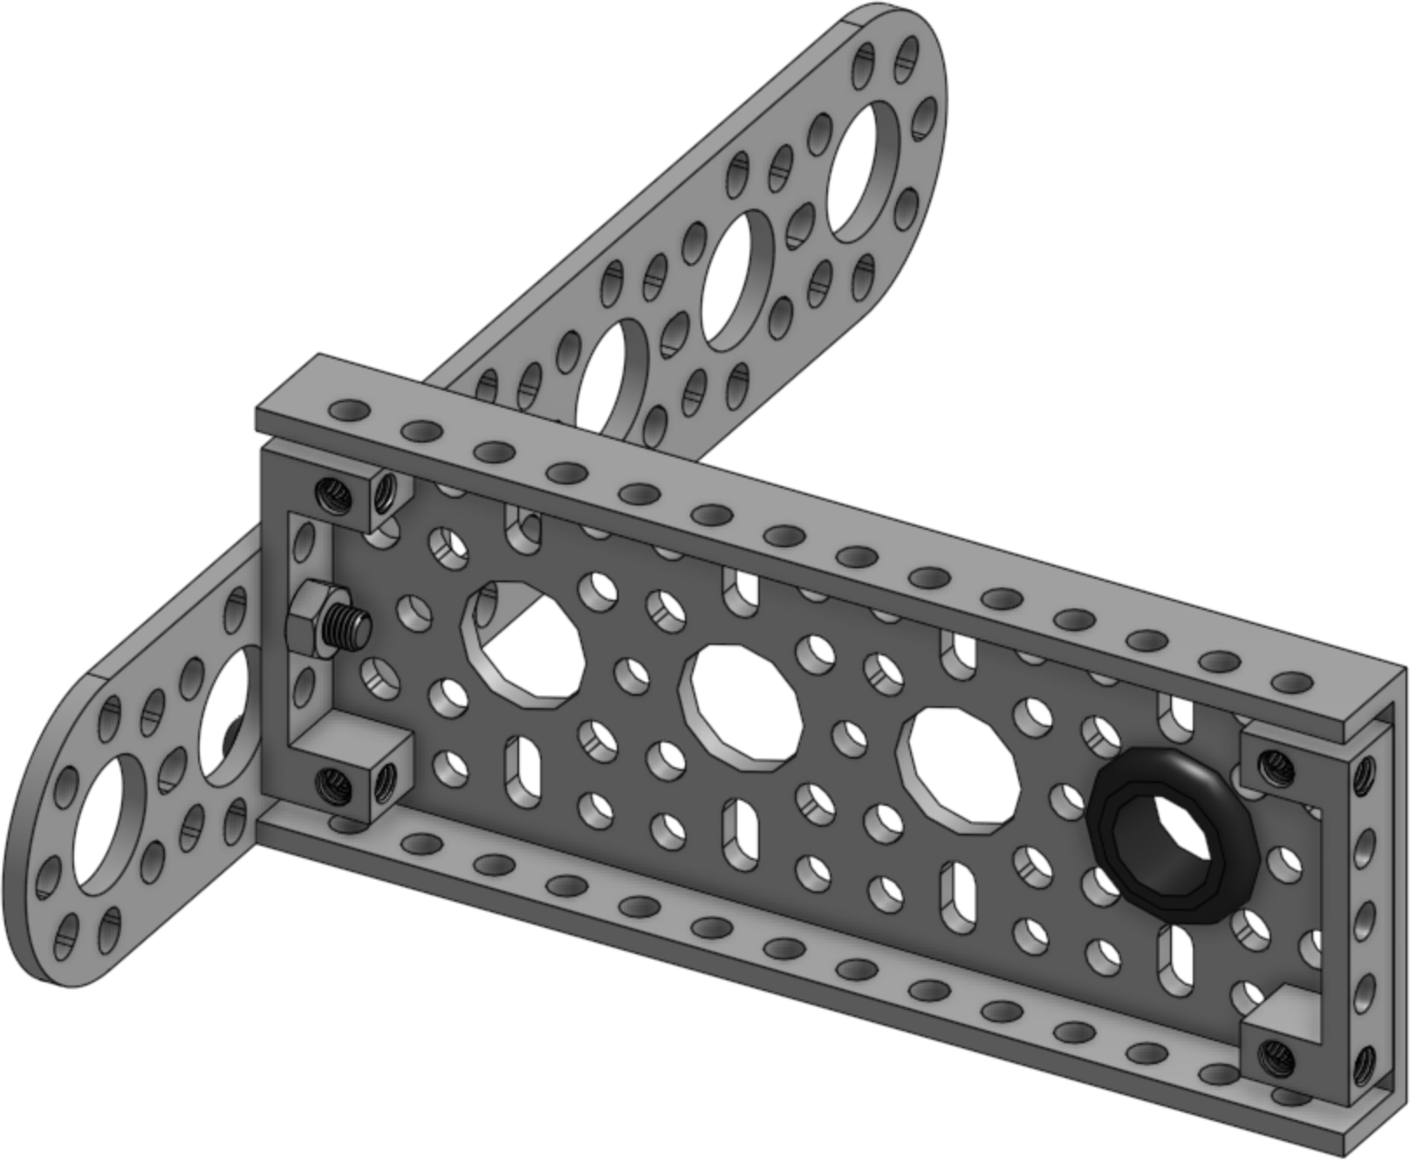
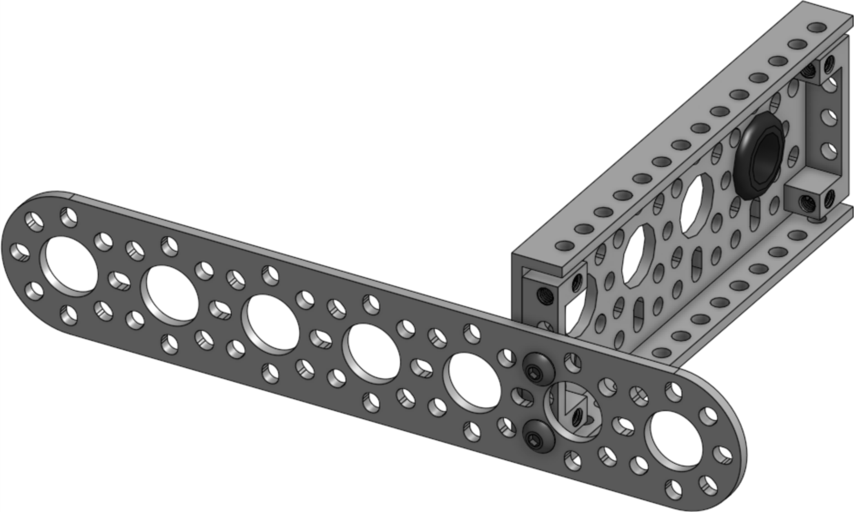
1
x1
x2
x1
x4(6mm)
2
x1(12mm)
x1
x1
x1(8mm)

Slide 6
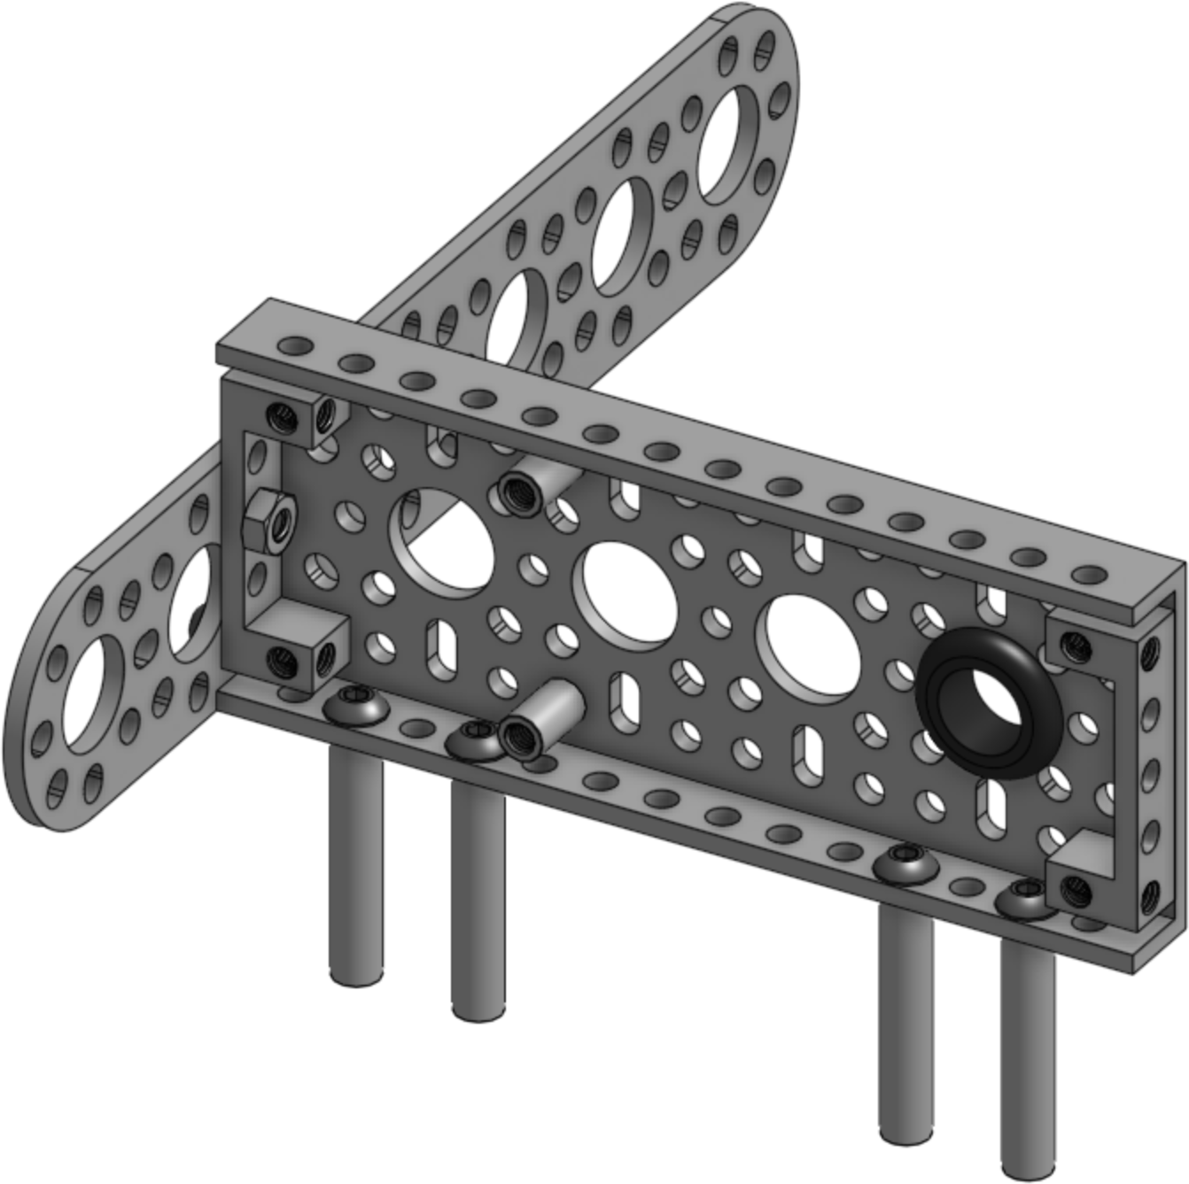
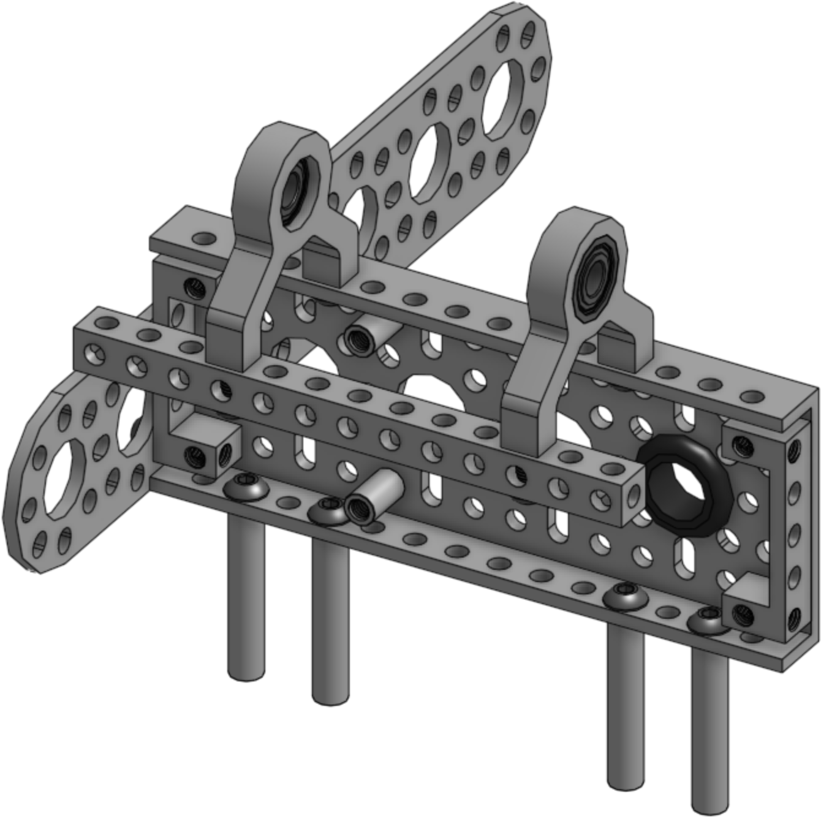
3
x4
x2
x6(8mm)
4
x1
8
x2
x2(12mm)
x2(8mm)
12

Slide 7
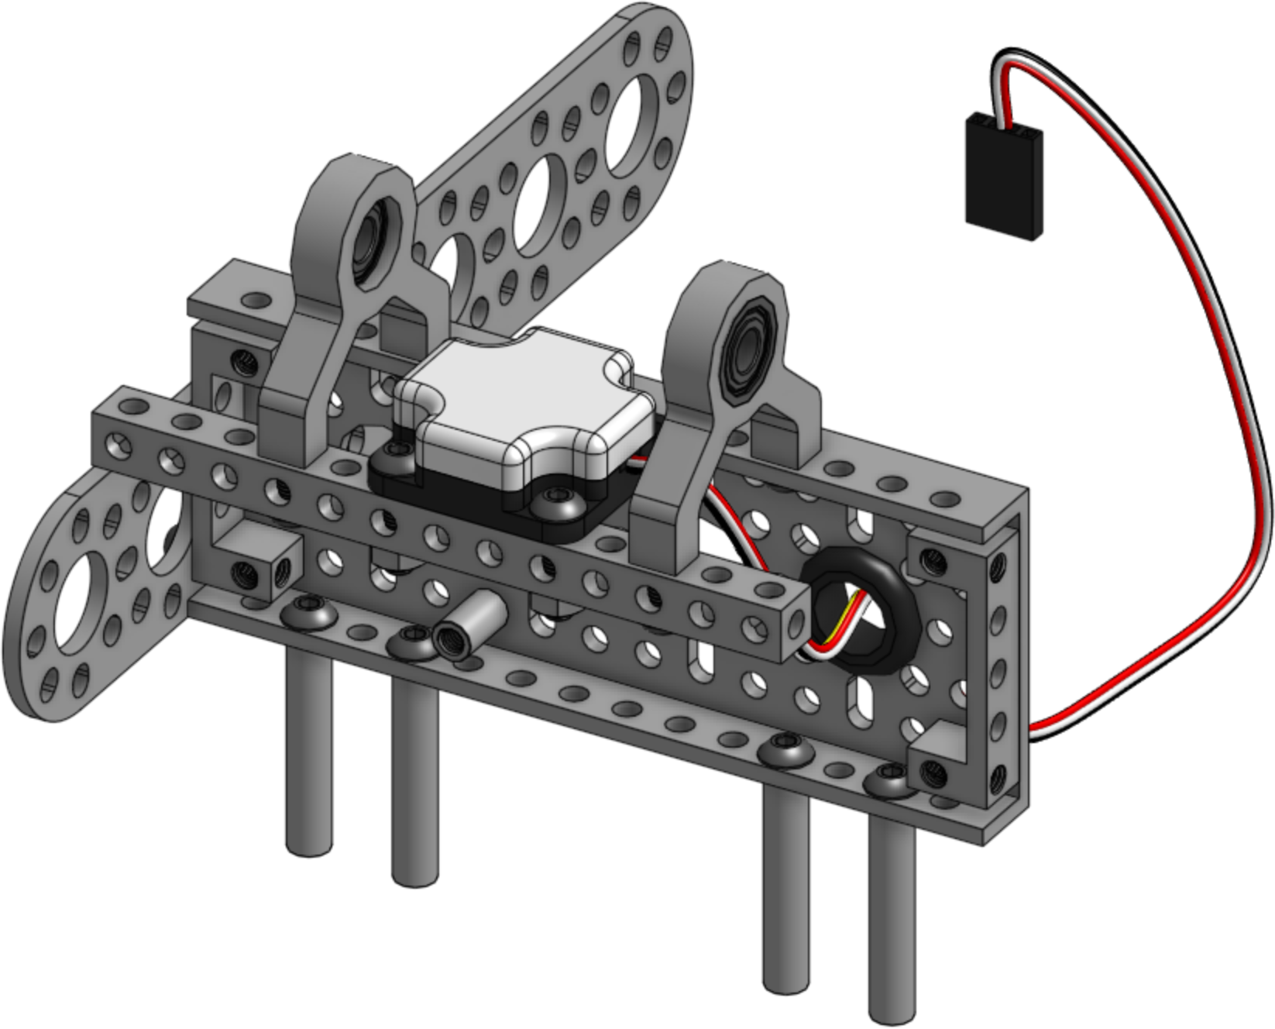
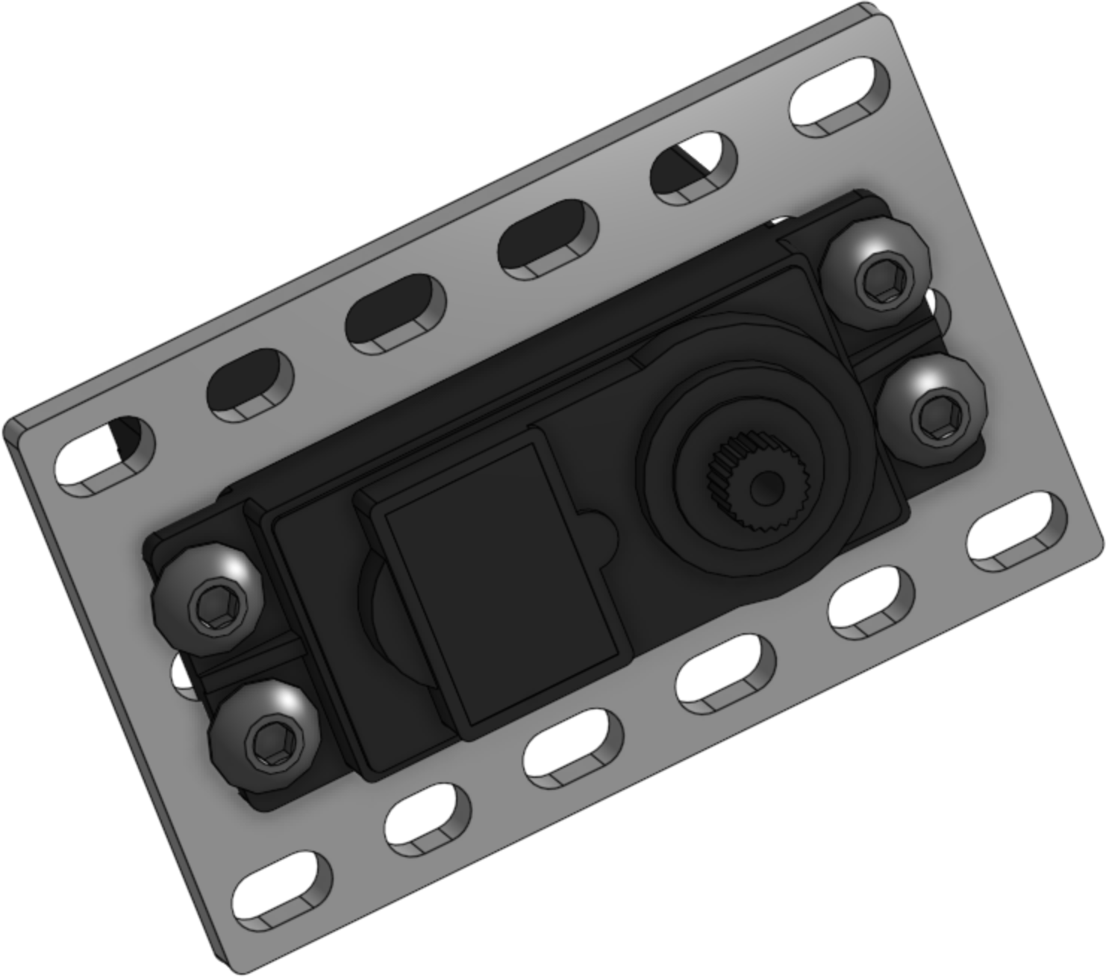
5
x1
x2(16mm)
x1
6
x1
x1
x4(6mm)

Slide 8




7
x2(6mm)
8
x2
x1 Cut to 30mm
10mm
10mm
10mm

Slide 9





9
x1
x1(16mm)
10
x1
Gently rotate your servo all the way
clockwise before completing this step
x1
Connect the servo horn to the servo with the ball linkage at the bottom

Slide 10



11
x2
x6(8mm)
12
x8

Slide 11


13
x2
x6(8mm)
14
x1(12mm)
x1
x1(8mm)
12
8

Slide 12


15
x1
x2(16mm)
x2
16
x1
x3(12mm)
x1
x1

Slide 13


17
x2
x6(8mm)
18
x3
x3(20mm)
x1

Slide 14


19
x2
x2
x4(16mm)
x2
20
x2
x2
x2(20mm)
x2(16mm)
x2(12mm)
16
12
x4
20

Slide 15


21
x1
x2
x2
x2(12mm)
A1
x4
A0
22
x1
x4(6mm)

Slide 16



23
Use the screw from Step 18 to fasten the motor to the mount. Be careful not to over tighten the screw.
x2
M0
M1
24
x2
x2
x8(16mm)
x2
x8

Slide 17


25
x2
Tighten the set screw down on the motor shaft.
26
x2
x2
x6
x2
x6(12mm)

Slide 18



27
x2(16mm)
x2
x1
x2
x2
x2(8mm)
16
8
28
x2
x2(20mm)
x2
x1
x1
x2(12mm)
x2
20
12

Slide 19


29
x2
x1
30
x4(8mm)
x1

Slide 20



31
x1(16mm)
x1
32
x1
x4(6mm)

Slide 21

33
x1
34
x1
x4(6mm)

Slide 22

Right Optical Distance Sensor | → | A0
Left Optical Distance Sensor | → | A1
Integrating Gyro | → | I2C
Right Motor | → | M0
Left Motor | → | M1
Servo | → | S0
Battery | → | BATT
M1
M0

